Slide 1
Grass forage options and performers
Jessica A Torrion
Northwestern Ag Research Center
Montana State University

Slide 2
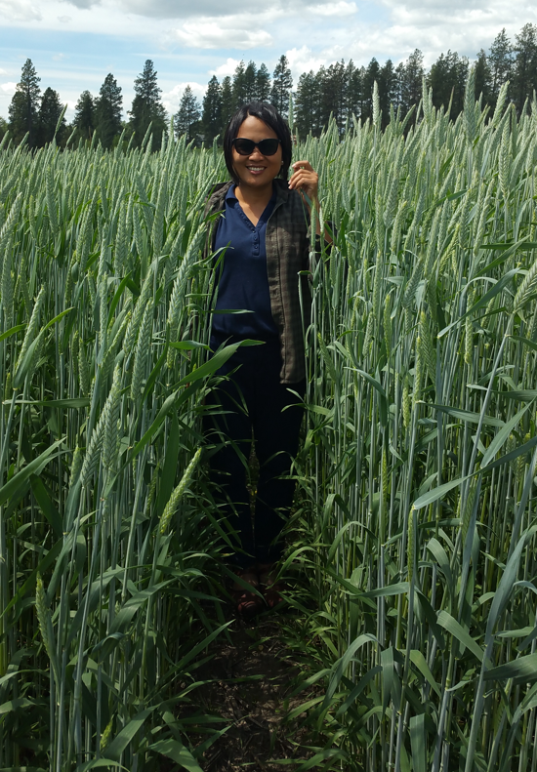
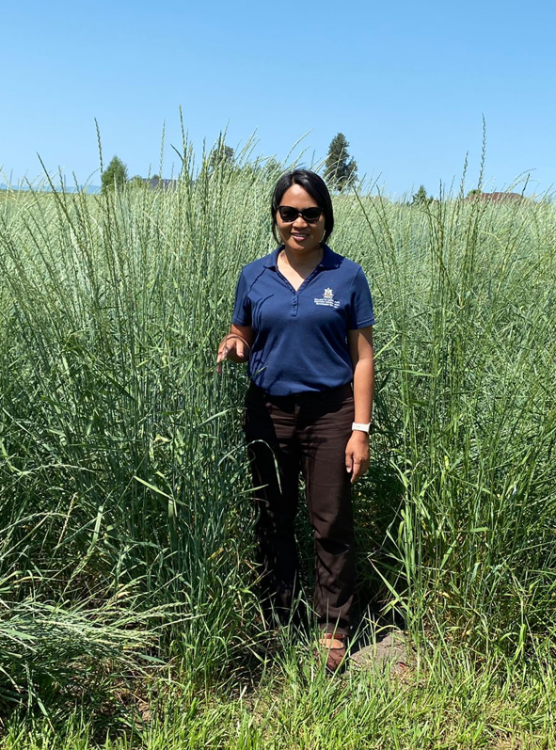

Slide 3
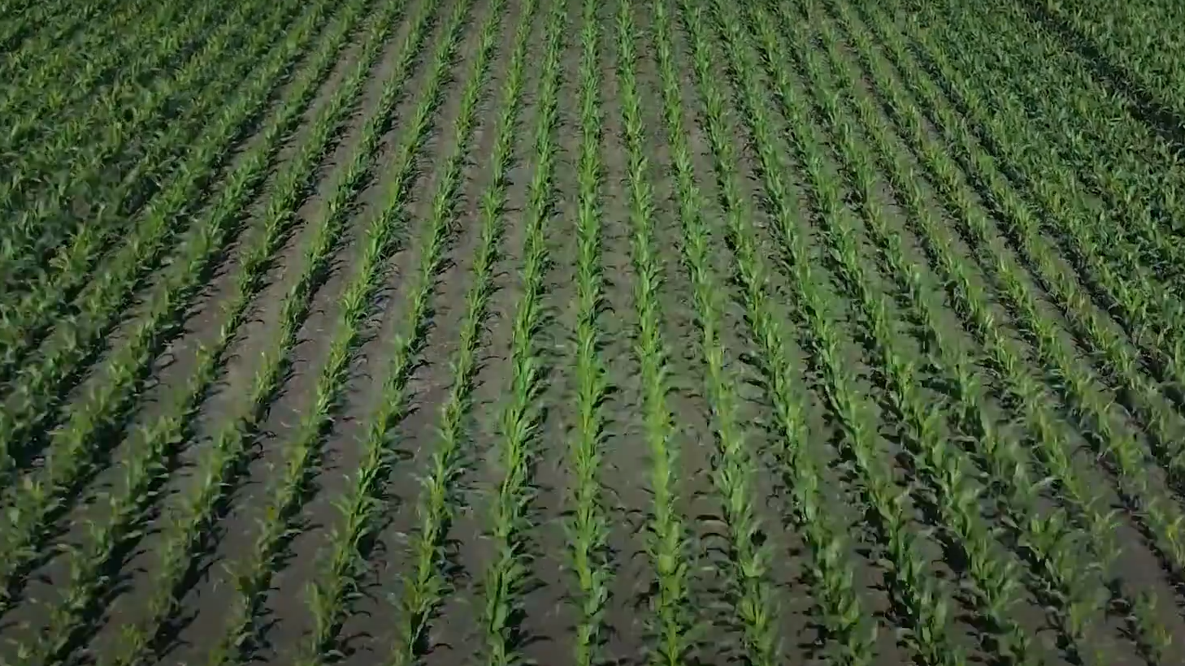
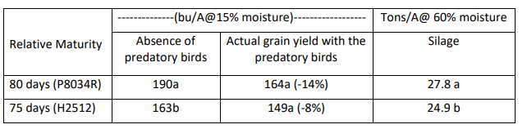
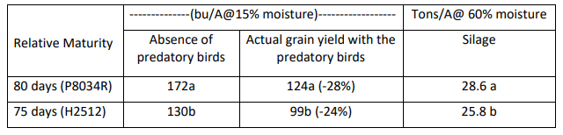
2019
2020

Slide 4
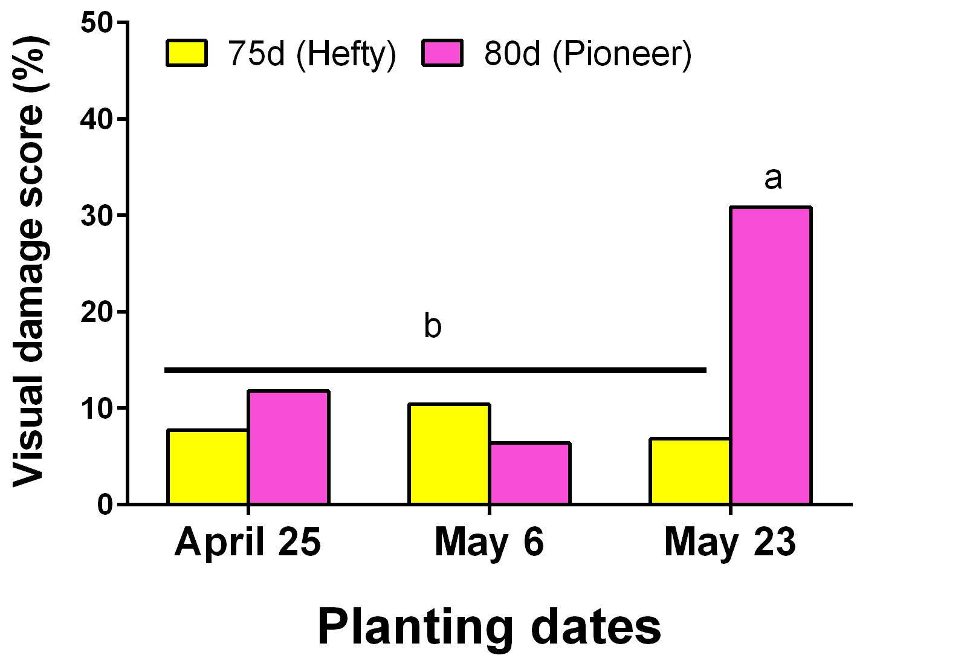
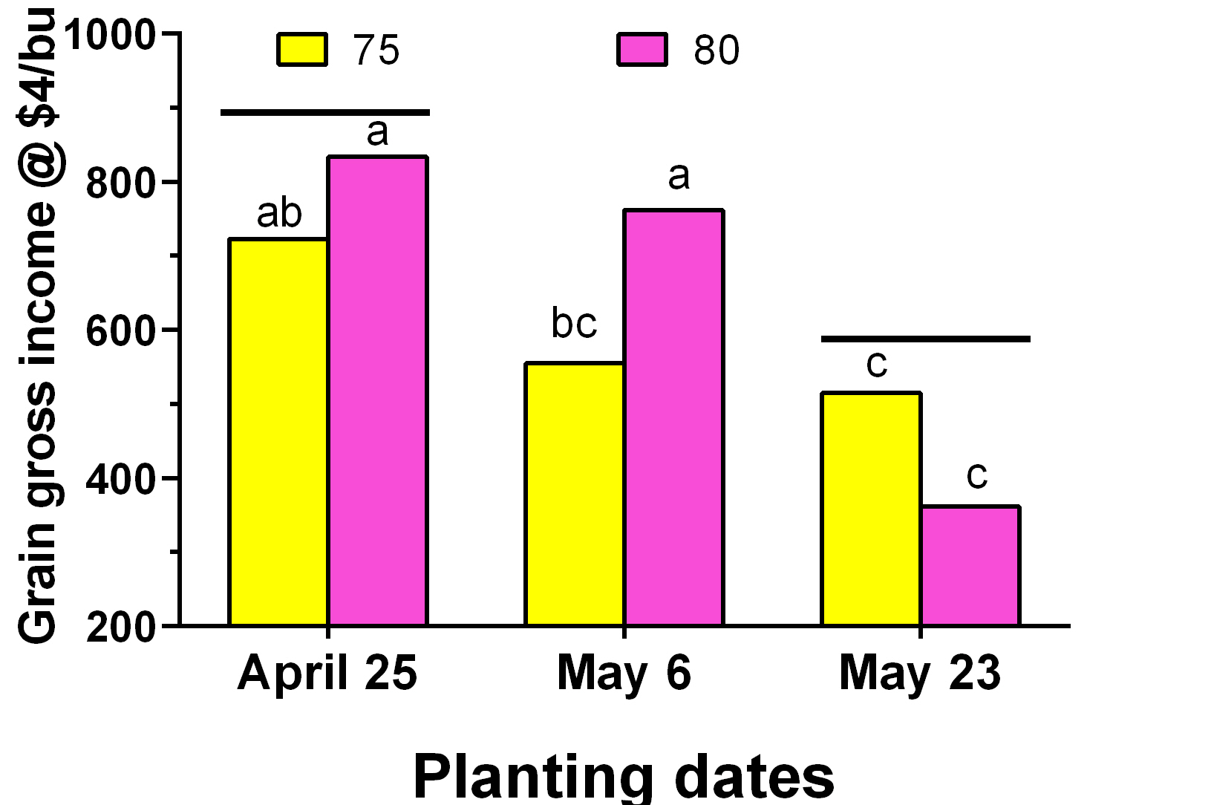
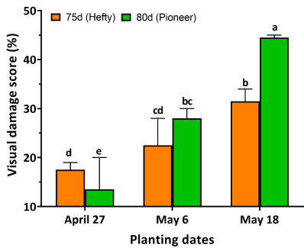
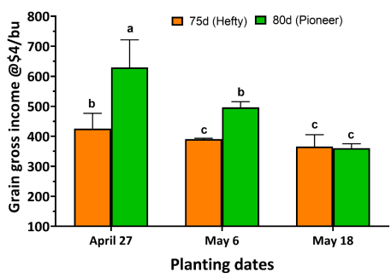
2019
2020

Slide 5
Takeaways:
yield reduction with delayed planting
higher yield potential with 80- day corn than 75-day, but the 80-day is prone to wildlife feeding and delayed harvest,
if corn is planted solely for silage purposes, then planting date doesn’t matter, and
the 80-day corn performed better as silage

Slide 6
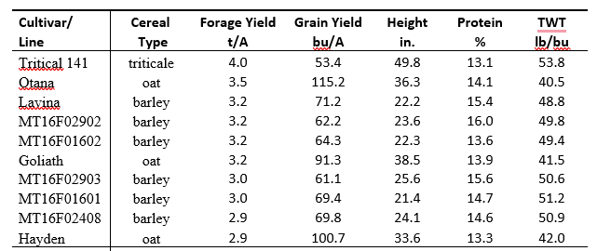
2019 Spring Cereal Forage
Forage LSD =0.5 tons/A

Slide 7
2019 Winter Cereal Forage
Forage LSD =1.6 tons/A

Slide 8
2020 Winter Cereal Forage
Forage LSD = 1.7 tons/A

Slide 9
2022 Winter Cereal Forage
Forage LSD = 1.5 tons/A

Slide 10
Takeaways- Annual Cereal Forages
1)Triticale provided greatest forage yield either a spring
or winter type
2) There are also new performing MSU forage lines for
release.
3) MSU Willow Creek and Ray also performed well after
triticale especially in 2022.

Slide 11

Cool-season and Warm Season Forages, 2019
Species | Type | Forage Yield (t/A)
Barricade dryland mix | CS | 1.9 b
HLR orchard grass | CS | 1.8 b
Oahe intermediate wheat grass | CS | 1.6 b
Luna pubescent wheat grass | CS | 1.1 cd
Timothy | CS | 0.3 d
Corvallis teff | WS | 3.6 a
Moxie teff | WS | 3.3 ab
Piper sudangrass | WS | 2.7 ab
Tifleaf pearl millet | WS | 1.6 bc
Crabgrass | WS | 1.0 d

Slide 12
Species | Forage Yield (t/A)
 | 2019 | 2020 | 2021 | 3-Year Total
Oahe intermediate wheat grass | 1.6 | 5.2 | 4 | 10.8
Luna pubescent wheat grass | 1.1 | 5 | 4 | 10.1
Barricade dryland mix | 1.9 | 5.4 | 1.7 | 8.9
HLR orchard grass | 1.8 | 3.3 | 1.8 | 6.9
Timothy | 0.3 | 2.9 | 1.8 | 5.1
Forage LSD 3-year total= 1.7 tons/A

Slide 13
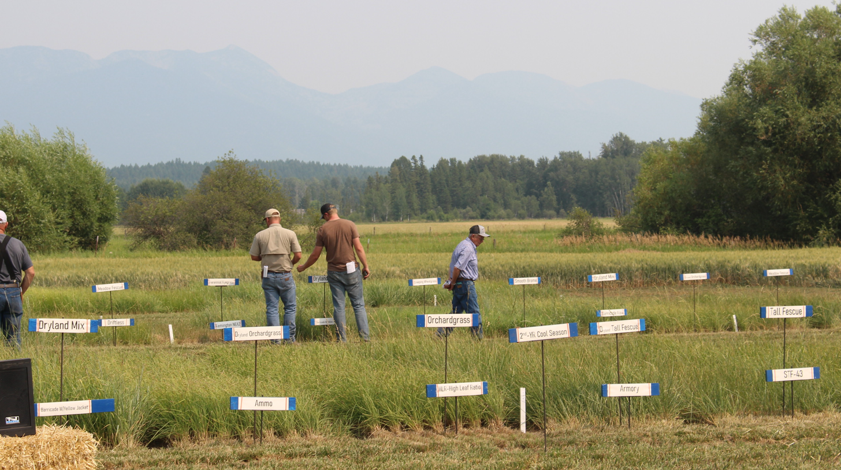
2020, 2021, & 2022

Slide 15
Takeaways- Cool Season Perrenial
Expect a better yield on the 2nd year of regrowth
Decline in 3rd year with similar yields across varieties
Perennial ryegrass has slow regrowth after the first cut
each year.
Performers: Tall fescue, meadow brome, smooth brome,
and dryland mix (t. fescue + s.brome + m.brome +int wht
  grass)

Slide 16
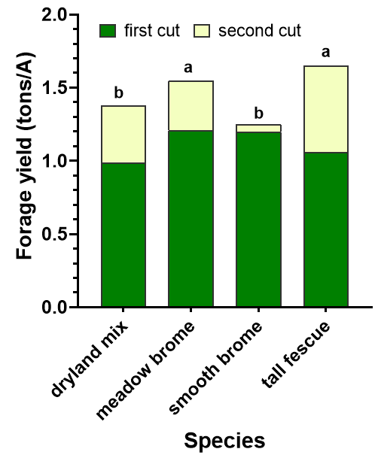
Perennial Forages
N Treatment | Yield (tons/Ac)
Control | 0.88c
50 lbs N at planting | 1.55b
25 lbs N at tiller + 25 lbs N after 1st cut | 1.53b
50 lbs N at tiller + 50 lbs N after 1st cut | 1.87a
MT Fertlizer Tax Committee

Slide 17
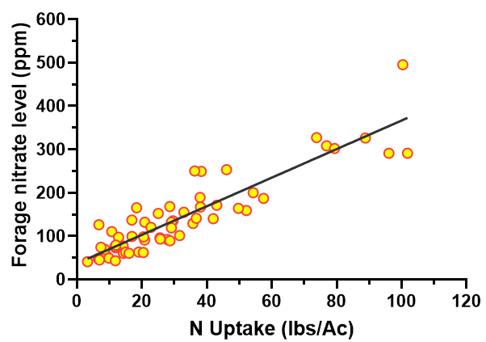
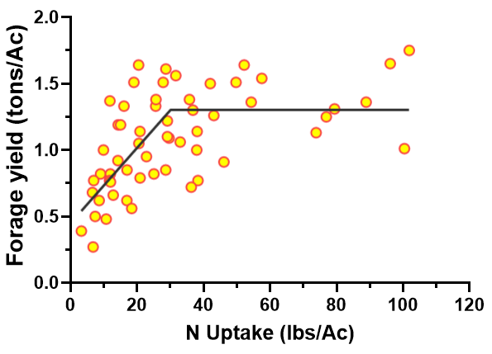

Slide 18
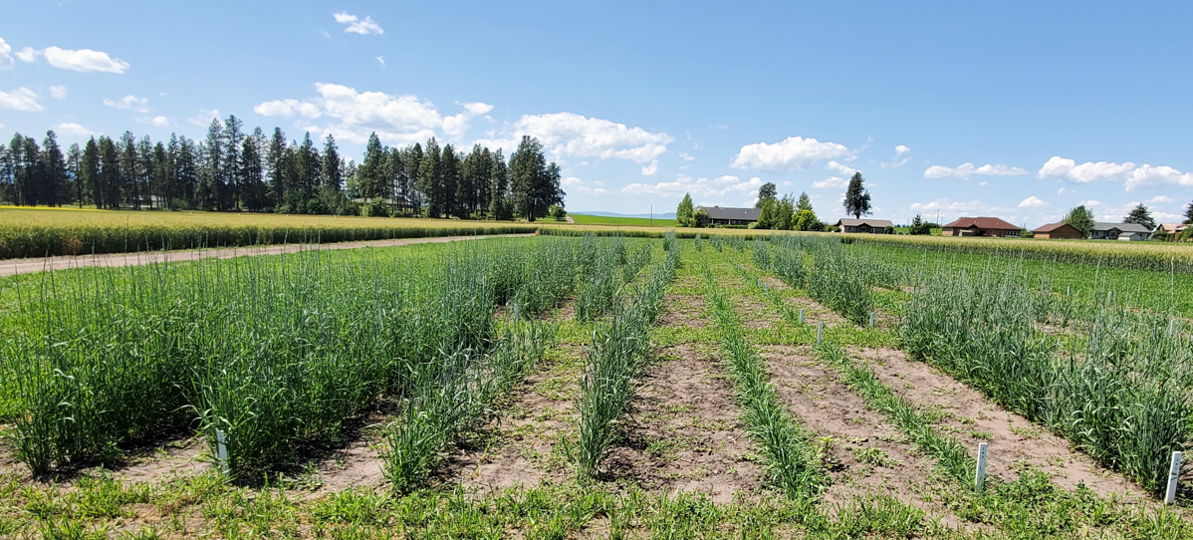
Intermediate Wheat Grass - KERNZA
9/20/2019
9/27/2019
04/17/2020
10/04/2019
05/01/2020

Slide 19
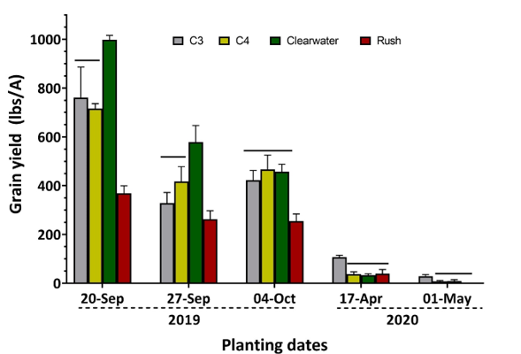
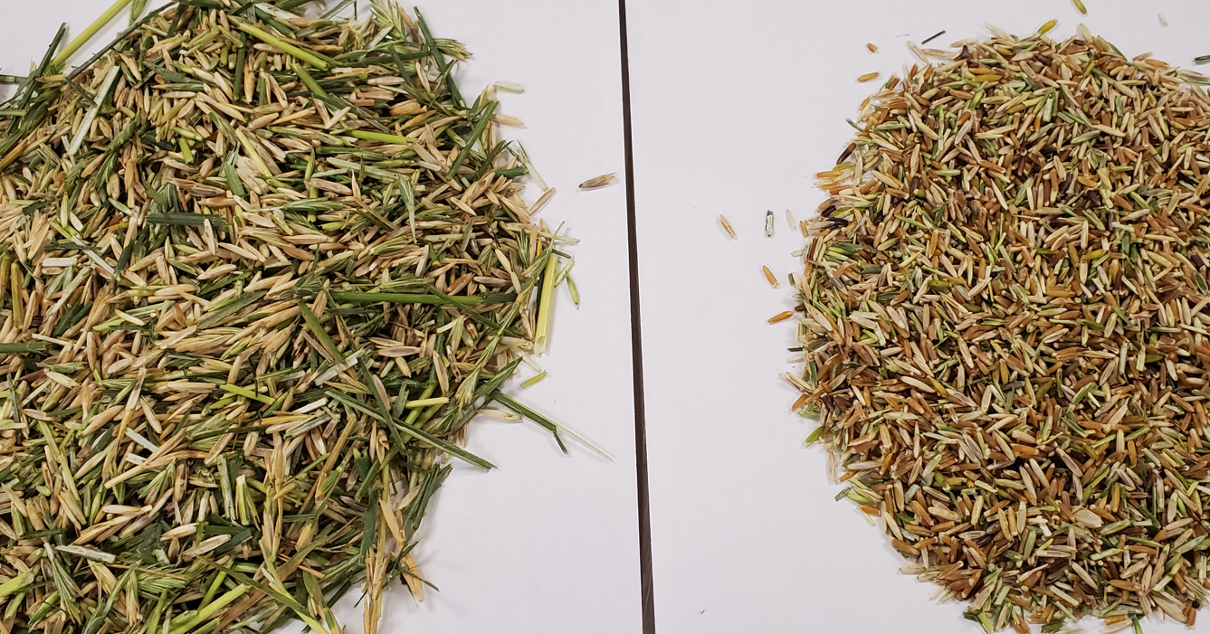

Slide 20
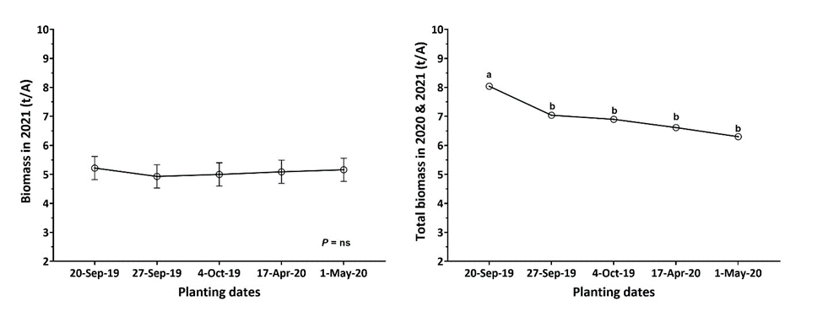

Slide 21
Takeaways- KERNZA
1) Plant around the same time as winter wheat planting.
2) The negative effect of delayed planting was recorded
only in the first year of establishment. In the 2nd year, all
planting dates had similar yields.
3) We still don’t know the optimal harvest time. Kernza
heads do not mature at the same time. Prone to shatter.
4) Combine settings close to canola settings?

Slide 22
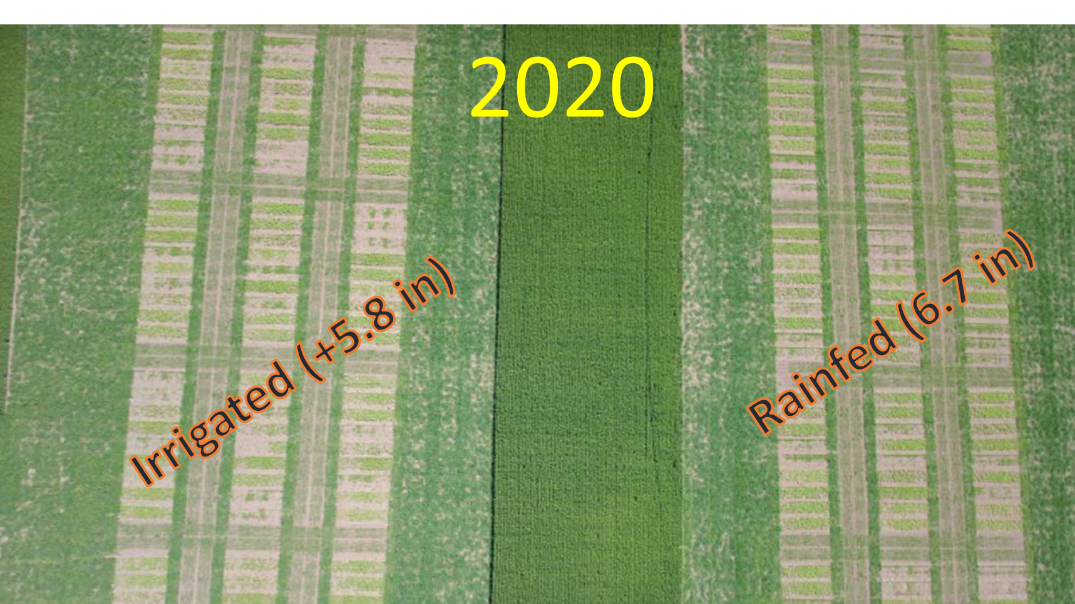

Slide 23
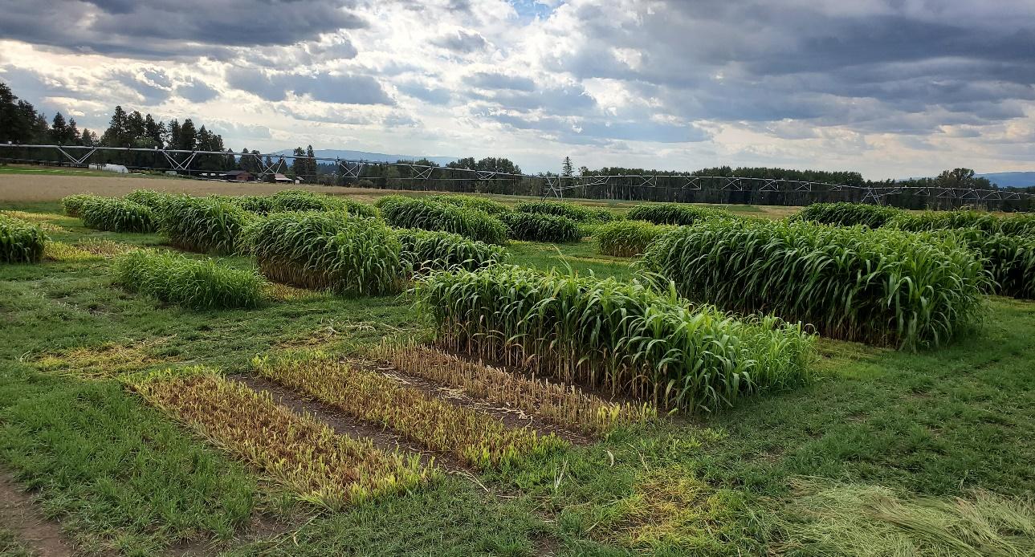
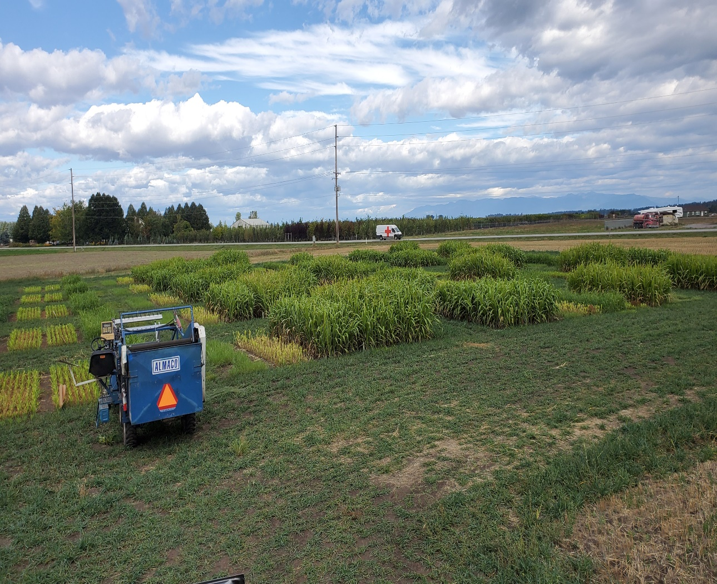
2021
+8”
Irrigated
3.8”
Rainfed

Slide 24
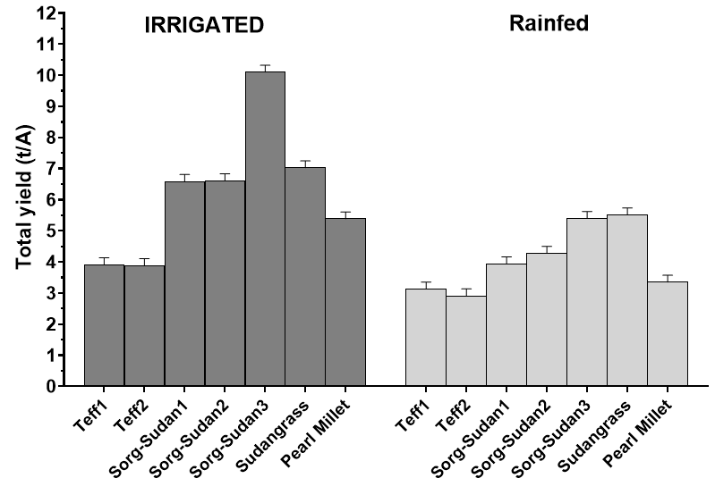
2020
Teff1 = 20BAR_ET
Teff2 = Corvallis
Sorg-Sudan1 = S5501
Sorg-Sudan2 = AS6402
Sorg-Sudan3 = S6504
Sudangrass = Piper
Pearl Millet = Tifleaf3

Slide 25
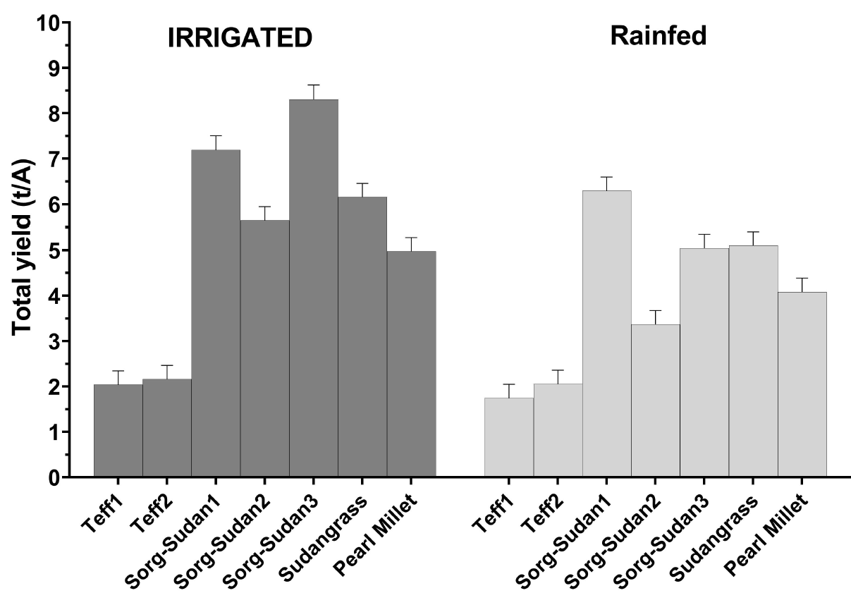
2021
Teff1 = 20BAR_ET
Teff2 = Corvallis
Sorg-Sudan1 = S5501
Sorg-Sudan2 = AS6402
Sorg-Sudan3 = S6504
Sudangrass = Piper
Pearl Millet = Tifleaf3

Slide 26
The higher the yield, the lower crude protein content
The higher the yield, the higher carbohydrates

Slide 27
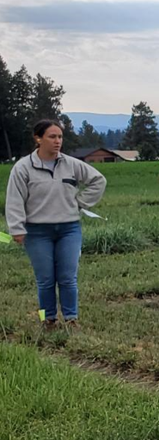
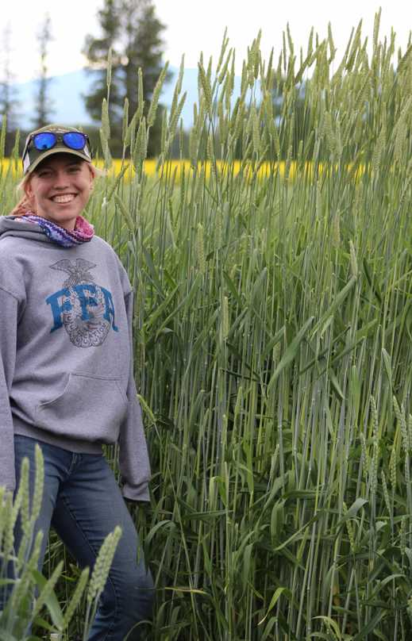
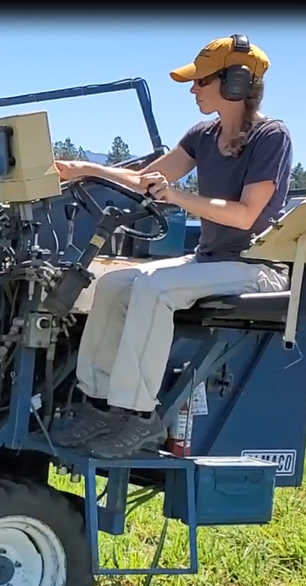
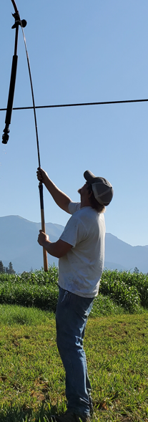
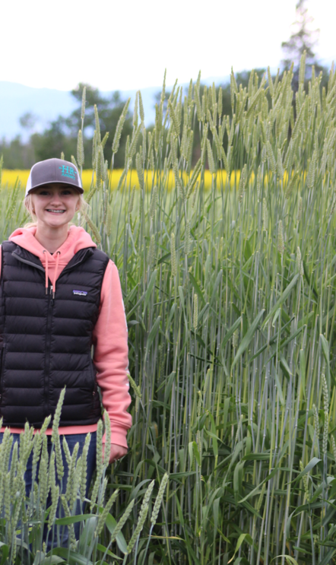
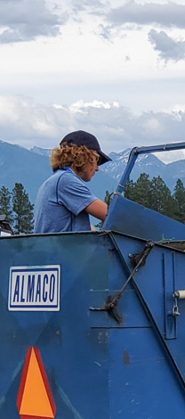
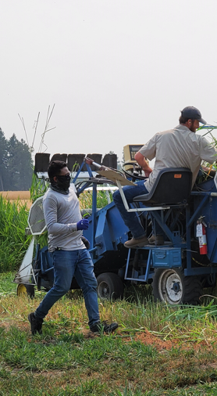
Thank you
MT Fertilizer Tax Committee

Slide 28
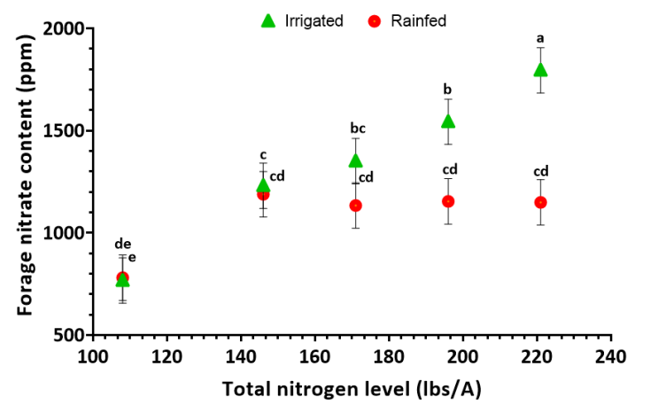
2020
Added N
0
75
100
125
150

Slide 29
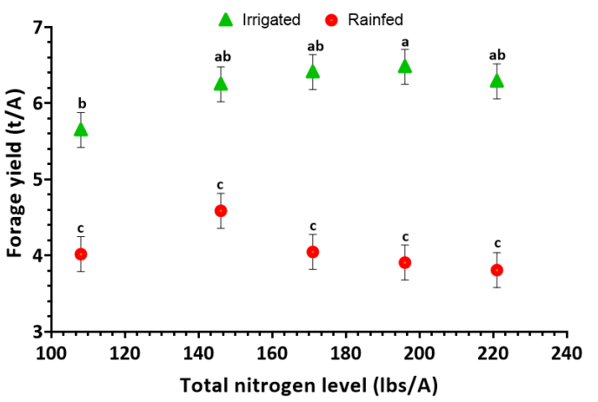
2020
Added N
0
75
100
125
150

