Slide 1
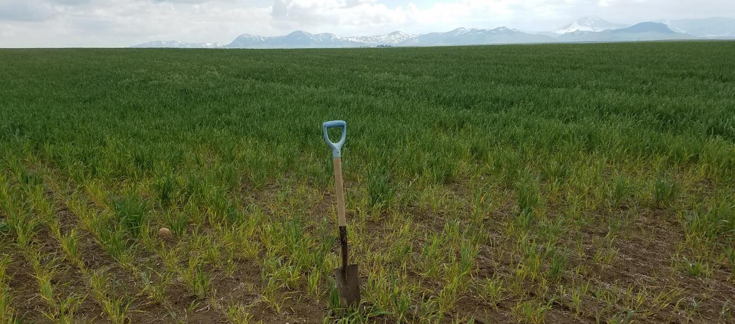

Montana soils are becoming acidic:
Why, How, and What can we do?
pH 5.1
NWARC Crop Production Update
January 17, 2023
pH 3.8
Images and some data courtesy Rick Engel, MSU
Manbir Rakkar: manbir.rakkar@montana.edu; 994-5295
Clain Jones: clainj@montana.edu; 994-6076

Slide 2
Are you seeing any soil acidity issues on your or clients’ fields?
Raise hand if you’ve measured soil pH below 6 on one of your fields or client’s fields

Slide 3
Today’s objectives
Why are Montana soils becoming acidic?
Why easy to miss this problem
What we can do:
  Mitigation (Liming)
  Adaptation (e.g. varieties)
  Prevention (e.g. 5 Rs)

Slide 4
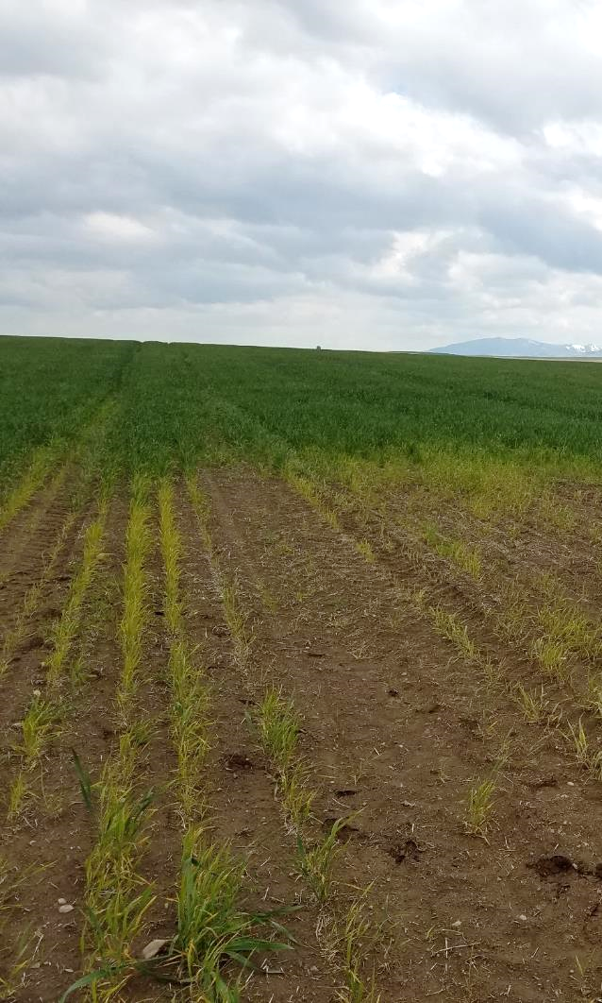
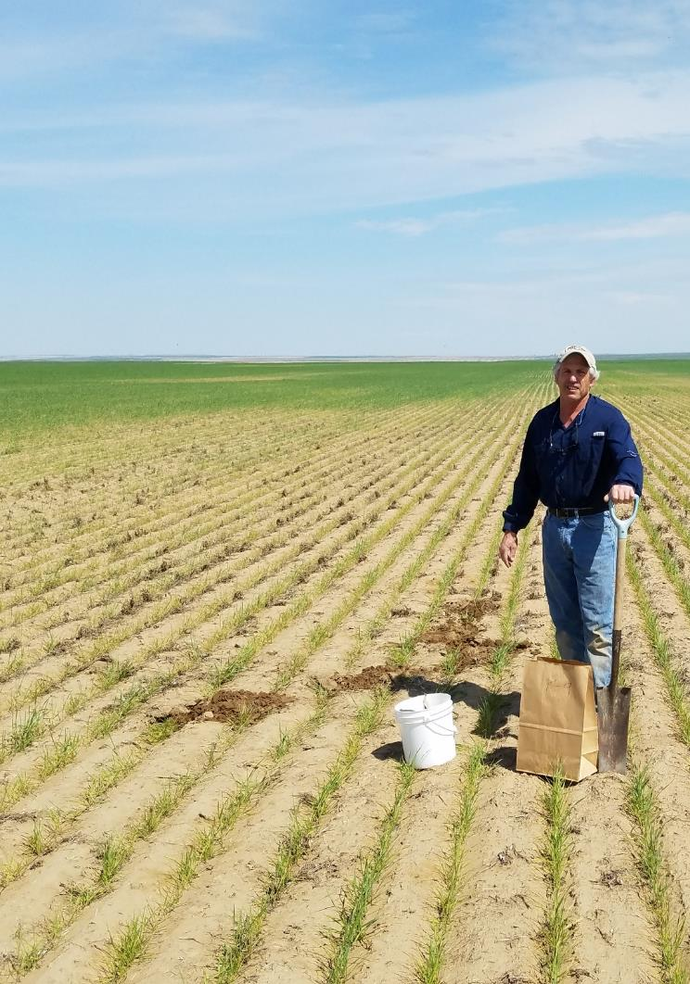
Crop loss due to soil acidification in Montana is not a myth
pH 5.1
pH 3.8
Images courtesy Rick Engel

Slide 5
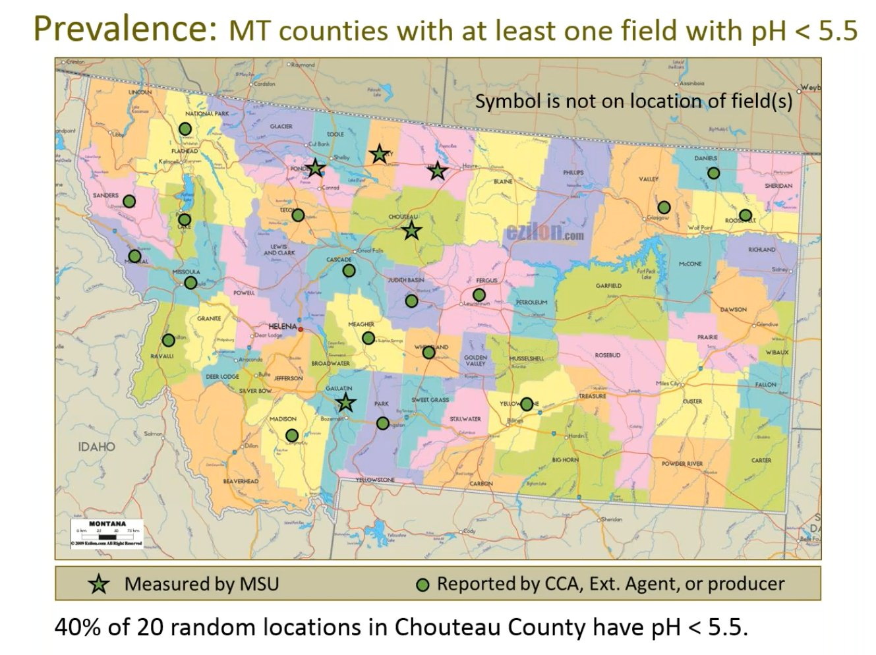
Soil Acidification: Prevalence in Montana
24 of MT’s 56 counties have ID’d fields with pH < 5.5

Slide 6
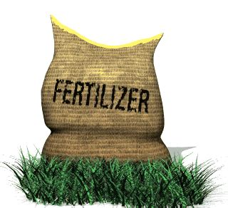


Why are Montana soils becoming acidic?
Agronomic:
Ammonium based fertilizer (e.g. urea)
H⁺
OH⁻
H⁺
Ammonium-N
Nitrate (NO₃⁻)

Slide 7
Why are Montana soils becoming acidic?
Agronomic:
Ammonium based fertilizer (e.g. urea)
H⁺
H⁺
Ammonium-N
Nitrate
Nitrate
Nitrate

Slide 8
How much does fertilizer affect pH?
Caused largely by ammonia-based N fertilizer
  Sandy clay loam (Big Sandy): pH drops 0.14 units for every 100 lb N/ac applied
  Silt loam: pH drops 0.044 units for every 100 lb N/ac (Engel, Ewing, Miller unpub. data)

Slide 9
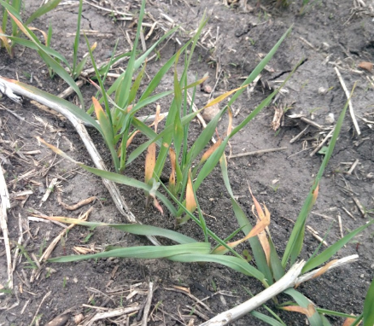
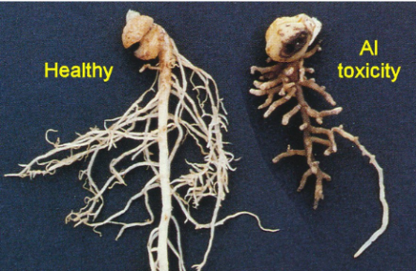
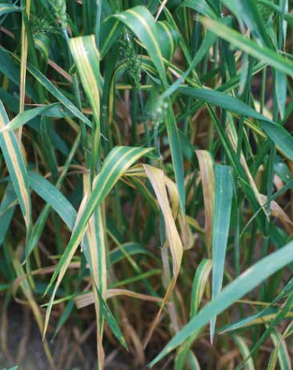
Soil Acidification: A serious issue
Have you seen:
  Unexplained herbicide damage?
  A change in herbicide action?
  Increase in fungal diseases?
  N deficient legumes, caused by poor N-fixation?
  Stunted yellow plants
“Unexplained” crop issues may be the first indicator of pH change.
Crop losses can be substantial, leading to a cycle of decreased soil health due to lack of residue input which further decreases yields.
Barley: Thom Weir, FarmersEdge
A. Robson, https://agric.wa.gov.au/n/4487
Image from Wheat Disease ID. MT Wht & Barley Co.

Slide 10
Why easy to miss this problem

Slide 11
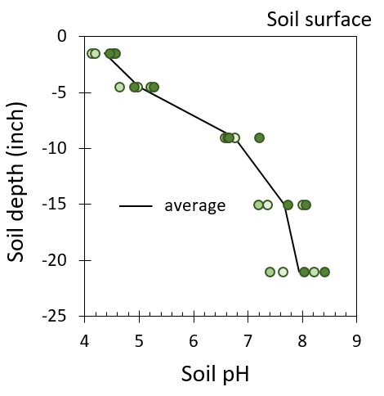
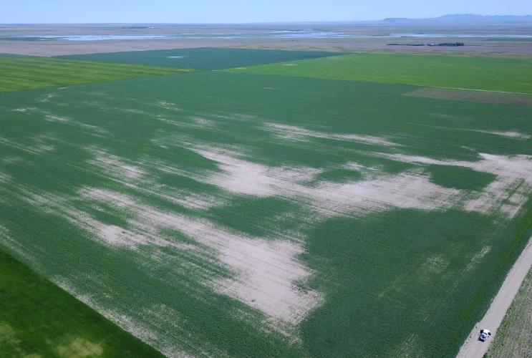
Your field may have soil acidity, but standard soil sampling (6” field composites) might not find low pH
Accurate characterization:
0-3” samples instead of 0-6”
Don’t composite samples across problematic field
Safflower field, image by Scott Powell
Engel unpub. data, MT
Symptoms are not uniform across field landscapes

Slide 12
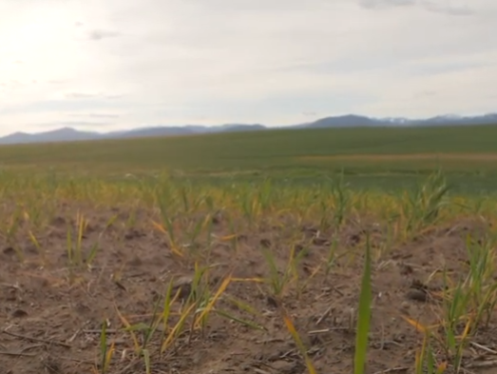
What to do about soil acidification
Mitigate:
Adapt:
Prevent: critically important

Slide 13
Soil acidity mitigation
Mitigation strategy:
  What products?
  How much?
  How often?
  How to apply?

Slide 14
Soil acidity mitigation: What products?
Lime: A calcium containing product with an oxygen containing compound
  Example: Ag lime, sugarbeet lime, prilled lime, etc.
Ag lime Prilled lime Spent lime
It’s the carbonate (CO₃²⁻) or hydroxide (OH⁻) that increase pH
Not effective to mitigate soil acidity: Liquid calcium (CaCl₂), Gypsum (CaSO₄)

Slide 15
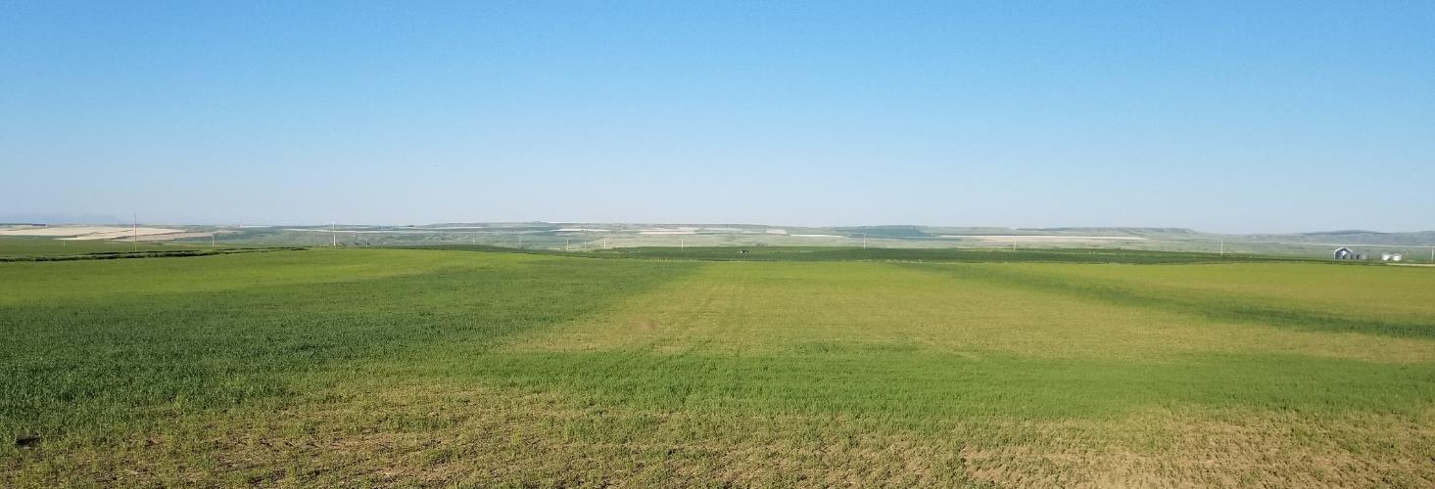
Mitigation: How much lime?
On-farm sugar beet lime strip trials
3 farms
0, 1, 2, 4, and 6-ton/ac SB lime
Incorporated with tillage on 2 farms, no-till on 3rd
Lentil, May 29, 2018 – lime applied Oct 31, 2017 + incorp with tillage
Lime
No-lime
Image by R. Engel

Slide 16
Mitigation: How much lime?
On-farm sugar beet lime strip trials
1.5 ton CaCO₃/ac per 1 pH unit for 6 inches
Lentil, May 29, 2018 – lime applied Oct 31, 2017 + incorp with tillage
Lime
No-lime
Image by R. Engel

Slide 17
Mitigation: How often?
pH: 0-2”
Lime benefits soil pH > 4 years after lime (4 ton/ac)

Slide 18
Mitigation: How often?
pH: 2-4”
Lime raised pH at one site but not at other at 2-4" depth
Why ?

Slide 19
Mitigation: How to apply?
pH: 2-4”
Till or not?

Slide 20
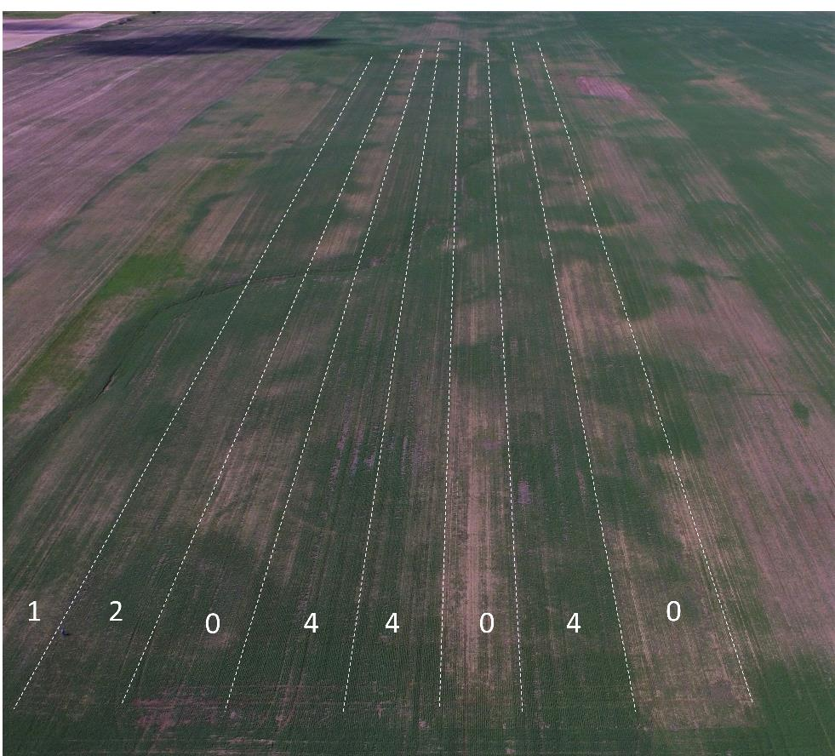
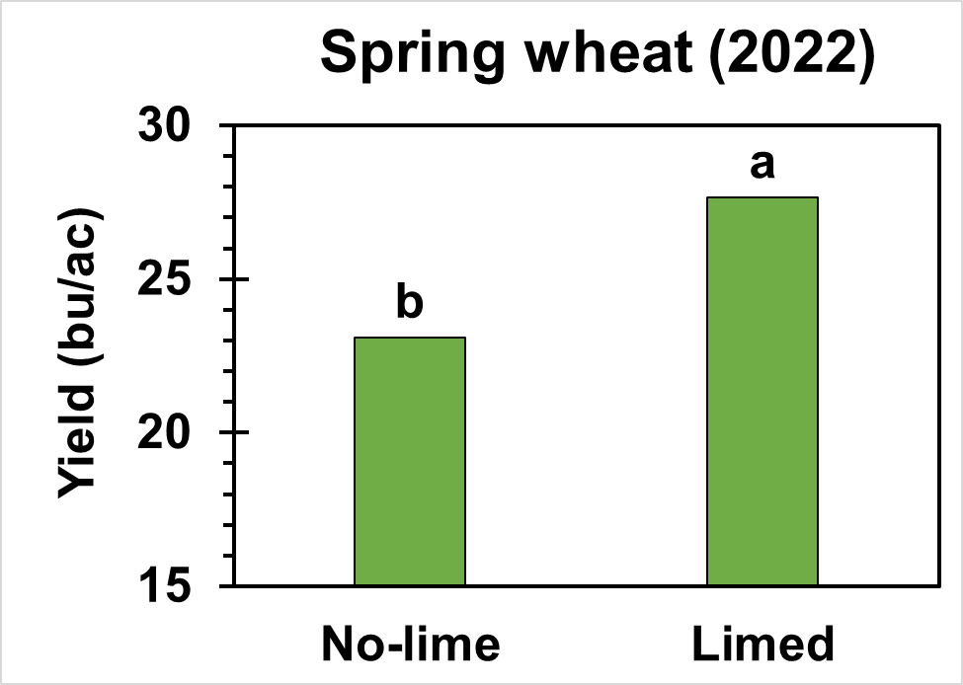
Mitigation: Yield in tilled-lime fields
Crop yields
Crop response to liming in MT over the years
2020 durum
Yellow pea (2019)
26% increase with liming
Residue increase?
Durum wheat (2020)
23% increase with liming
Residue increase?

Slide 21
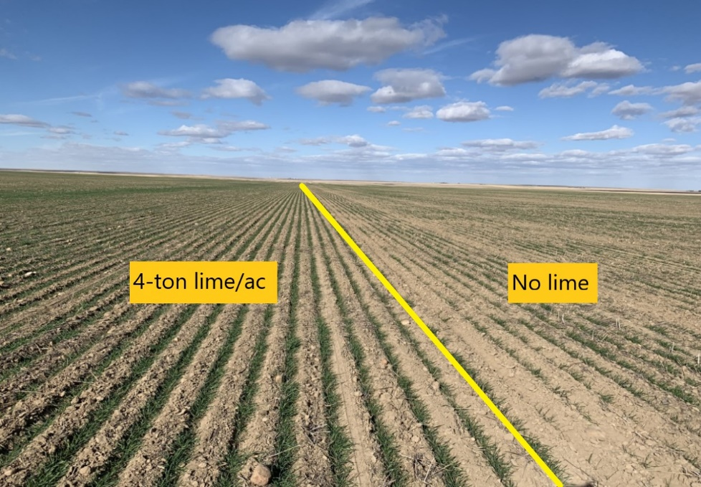
Mitigation: Yield in NOT-tilled lime field
On average, yield was no higher in limed versus no-lime strips.
Lot of variability, possibly due to drought conditions!
Winter wheat emergence 4 year after spent beet lime
Notes:
Lime benefits persists in no-till even after 4 years in 0-2” but no to minimal change in 2-4”. 4 ton/lime showed better winter wheat emergence, would that show benefit in crop yield?- we will determine that next yr.

Slide 22
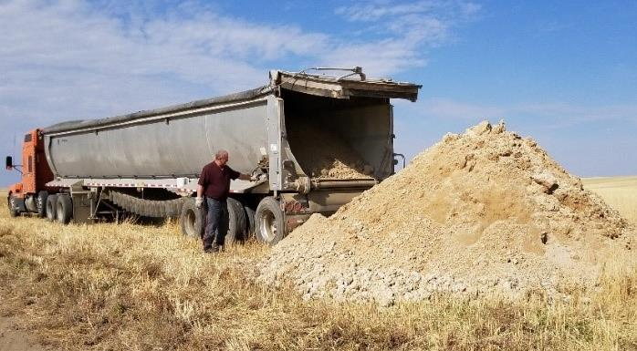
Liming is expensive!
Sugarbeet lime (~4 ton/ac): $145/ac (hauling cost)
Lime spreader: ~$55k
Prilled lime: $250-300/ton (excluding shipping/applying)
Site specific application can save $$
Only liming low pH areas is more important than exact rate
Image by Rick Engel
Notes:
SB lime about $35 to haul/ton x 3.75 ton lime = $131.25 plus $12/ac to spread = about $145/ac

Slide 23
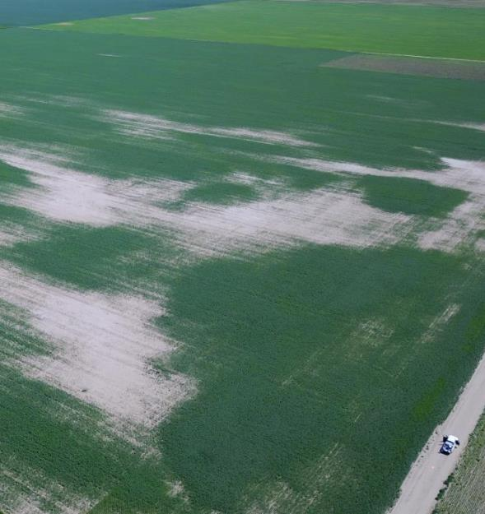
Save $$$$
Site specific application can save $$
  Grid sampling
  Veris
Drone image by Scott Powell
Notes:
SB lime about $35 to haul/ton x 3.75 ton lime = $131.25 plus $12/ac to spread = about $145/ac

Slide 24
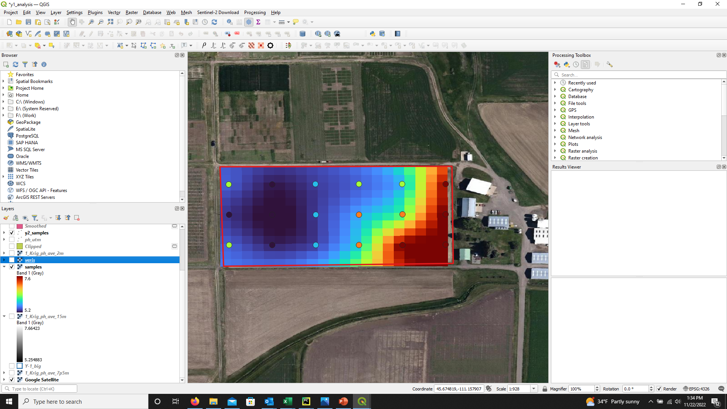
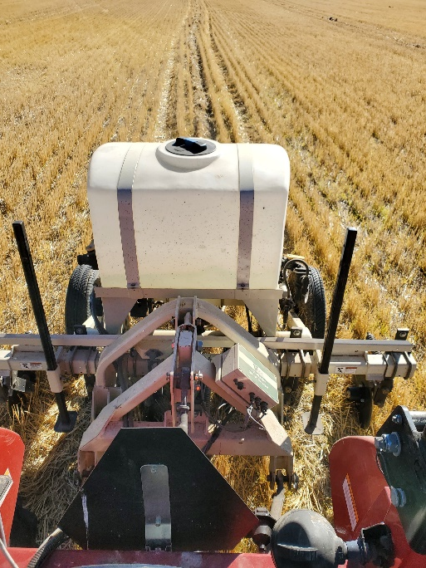
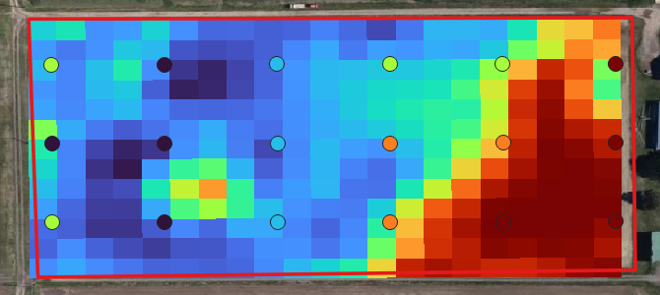
Save $$$$
Site specific application can save $$
  Grid sampling
  Veris
Soil pH scale
Grid sample
Lab Data
Veris Data
Veris MSP3 on Post Farm G-3
Nugent et al. unpub
Notes:
SB lime about $35 to haul/ton x 3.75 ton lime = $131.25 plus $12/ac to spread = about $145/ac

Slide 25
Adaptation and Prevention

Slide 26
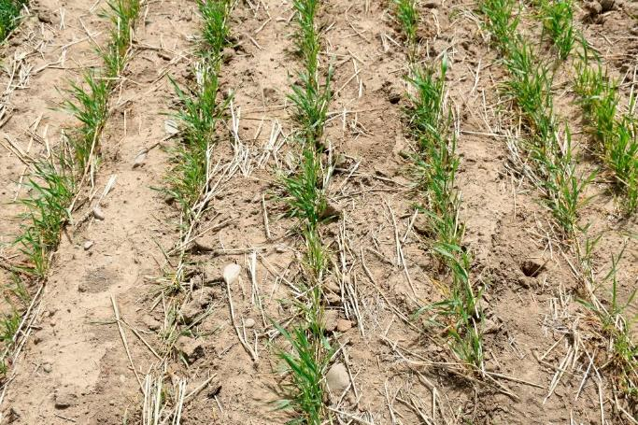
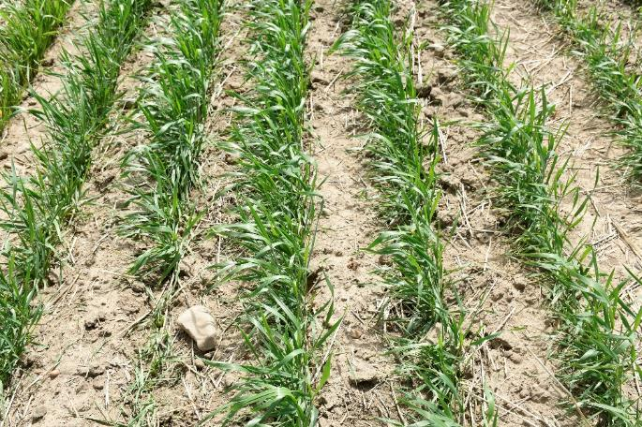
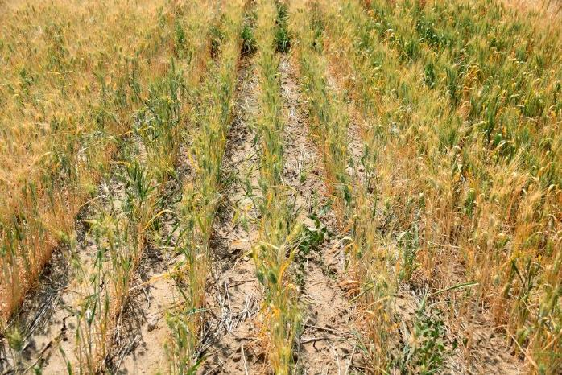
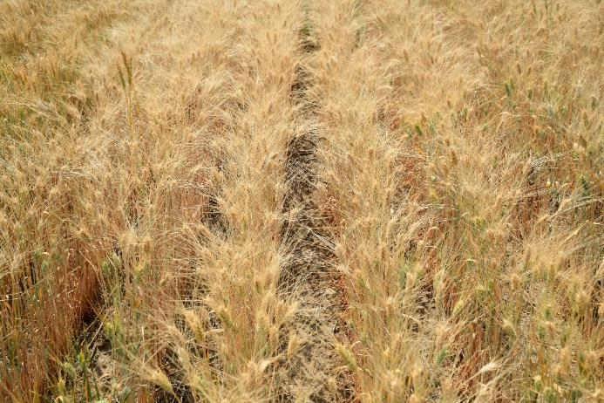
Seed-placed P caused largest P response observed by R. Engel in 36 yrs of field work, on a site with very high soil test P
0 P
Olsen P 48 ppm, pH 4.4
90 lb P₂O₅/ac
Durum w/out and with seed-placed P
Big Sandy, MT dryland production
Jones and Miller unpub data

Slide 27
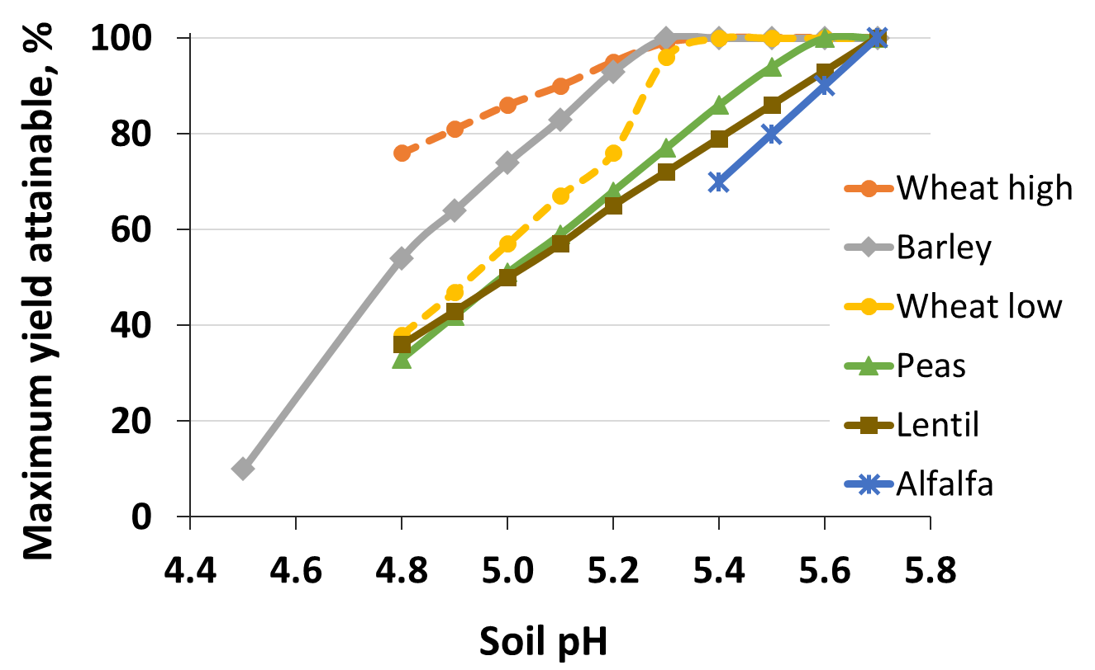
Plant tolerant crop species. Durum is low tolerant cereal, legumes (or their rhizobia) are least tolerant.
“Wheat high” are Al and acid tolerant varieties
Mahler and McDole 1987
Long pers comm

Slide 28
Perennials?
Liming is expensive…you want to avoid tilling lime…..
NEED to start preventing now!
Increase N use efficiency
  Base on realistic yield potential
  Soil test in spring when possible
  Apply shortly before uptake
  Split application
  Plan crop rotations to catch residual N
Legumes in rotation – no N fertilizer and residue increases soil surface pH more than non-legumes (Paul et al. 2003)
Leave crop residue (and their buffering ions like Ca²⁺ and Mg²⁺ in field)
Notes:
caclium ammonium nitrate is 20% dolomitic lime. when do the math at say 100 lb N/ac that's not nearly enough to counteract acidity (20 lb lime vs say 1 ton/ac lime) but we have literature that shows less acidifying than urea. Not sure why it's 1/3 as acidifying; it might be the Ca and Mg help buffer so not just a lime effect.

Slide 29
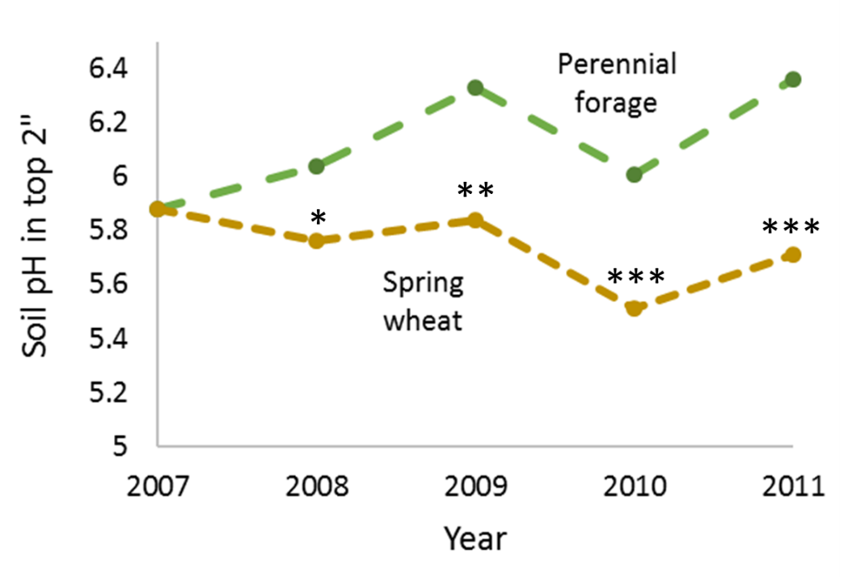
Perennial forage can maintain or increase soil pH
60% canopy cover
Intermed WG 35%
Meadow brome 20%
Slender WG 5%
Pubescent WG 1%
Bluebunch WG 0%
Indian ricegrass 0%
pH differs between crops with * > 90%, ** > 95%, *** > 99% confidence, Mandan, ND, Liebig et al., 2018

Slide 30
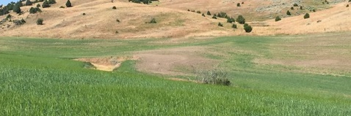
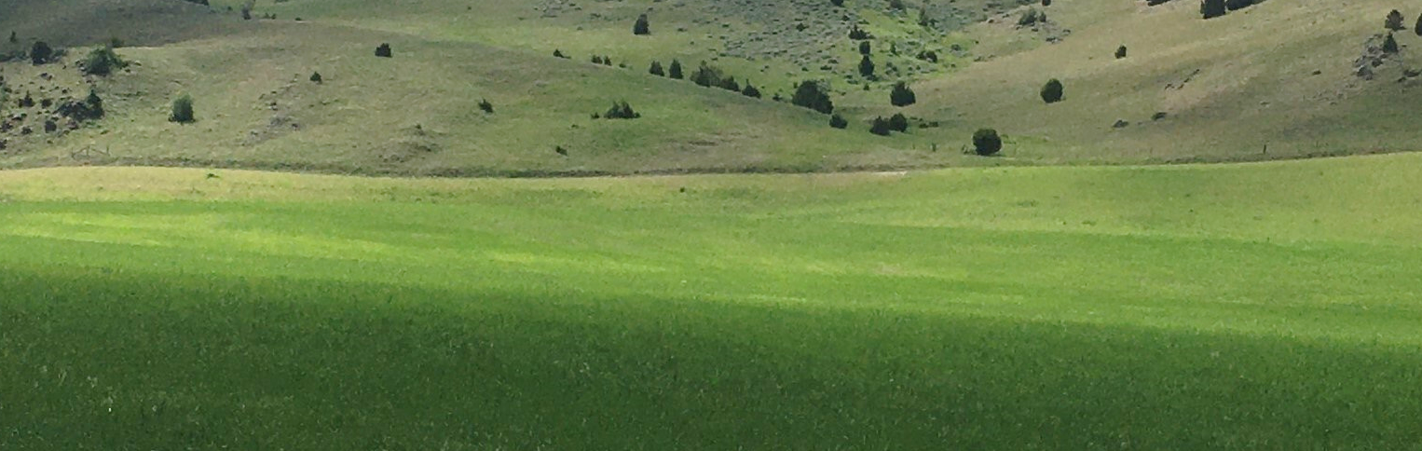
Rotating with perennials (good risk mgmt. in drought)
pH 4.12
0-3”
Barley 2017
6-species mix grass seeded 2018
Photo 2020
Jones unpub. data
60% canopy cover
Intermed WG 35%
Meadow brome 20%
Slender WG 5%
Pubescent WG 1%
Bluebunch WG 0%
Indian ricegrass 0%
MT variety trial results http://landresources.montana.edu/soilfertility/acidif/index.html

Slide 31
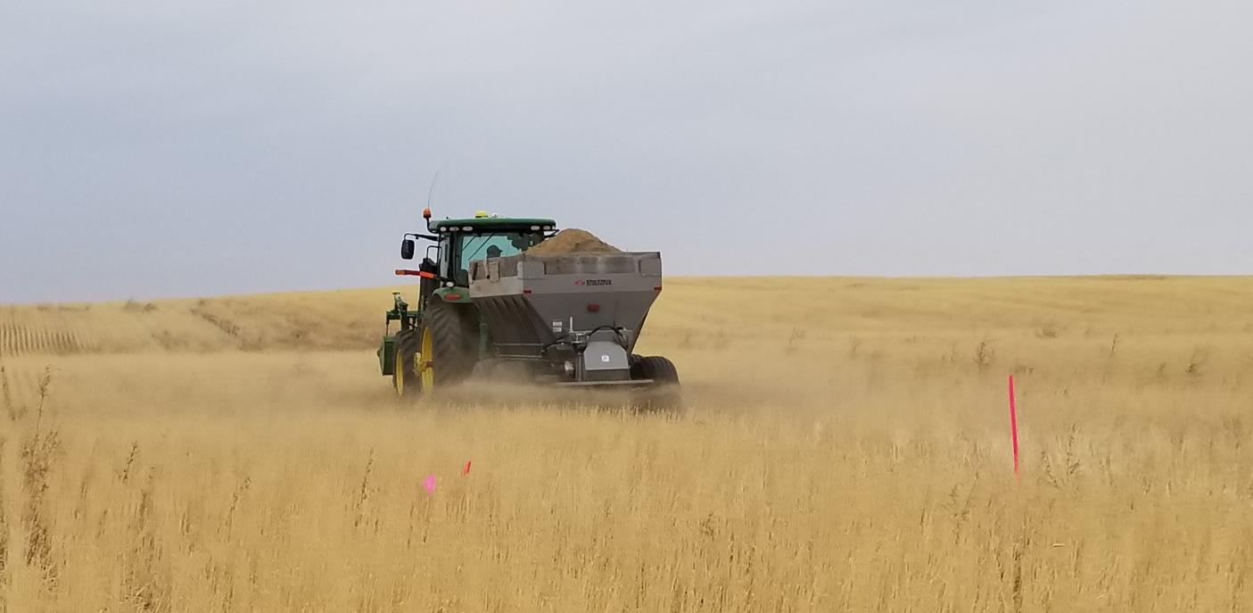
Summary
Cropland soils are becoming acidic, largely due to N fert.
Identify potential problem now to avoid a train wreck later
6” field composite pHs often do NOT identify pH issues
Lime and perennials can reverse acidification
Adapt: Plant acid tolerant varieties or adjust P fertilizer
Prevention and catching problem early ARE KEY
  Encourage high N-use efficiency practices
  Include perennials and legumes
Safflower field, image by Scott Powell
Image courtesy Rick Engel

Slide 32
Thank you!
Questions?
Limed
Not limed
Image from Oregon State University, Lane County, OR 1926.
Contact: Manbir Rakkar: manbir.rakkar@montana.edu or (406) 994-5295
Clain Jones: clainj@montana.edu or (406) 994-6076
Website: http://landresources.montana.edu/soilfertility/acidif/index.html

