Slide 1
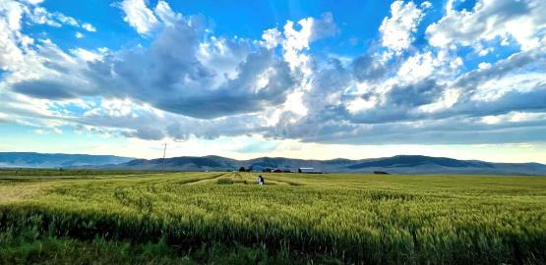
2023 Winter Wheat Breeding & Research Updates
Dr. Sue Mondal
Winter Wheat Breeder

Slide 2
Background
Worked in …..
Breeding for abiotic stress tolerance – heat & drought
Genomic and phenomic technologies in improving selection efficiencies
Rapid cycling for accelerating gains
Spring Wheat breeding and research, 2011 - 2022
Graduate school, MS & PhD, 2005-2011

Slide 3
Winter Wheat Breeding Program at MSU
Core Objectives:
Breed for high and stable yielding winter wheat varieties
Ability to tolerate drought stress art early and late season
Resistance to Wheat Stem Sawfly (WSS)
Resistance to diseases: stripe rust & stem rust
Winter hardiness
End use quality

Slide 4
Winter Wheat Breeding Program at MSU
Core Objectives:
Breed for high biomass forage winter wheat varieties
High biomass with adequate seed yield
Protein, NDF and ADF

Slide 5
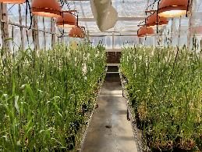
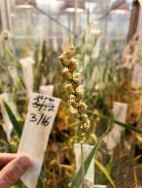
Breeding program pipeline
Crosses
Selfing
(5 years ) F1-F5
Select:
Disease resistance (inoculate or natural infection YR and SR at Ft. Ellis)
Agronomy
Winter hardiness (Williston, ND)
Select:
Agronomy
Disease resistance
10 years
10 years
Headrows
Select:
Across locations agronomy
Sawfly resistance
Single rep yield trials
Prelim yield trials
Multilocation across Montana
Advanced yield trials
Multilocation across Montana
MT WarCat
Intrastate/Offstation yield trials
Multilocation across Montana

Slide 6
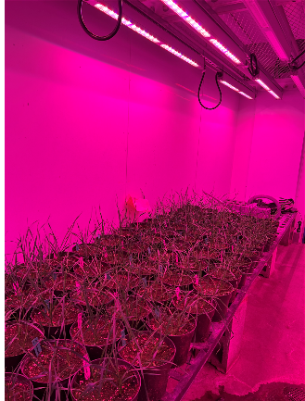
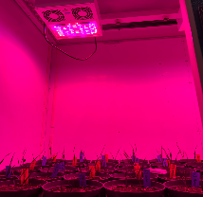
Reducing breeding cycle time…
Rapid cycling in greenhouse
Issue
vernalization : exposure to cold temperatures required for flowering, about 7-8 weeks in growth chamber at 4C followed by 3.5 months in greenhouse ( total 5-6 months)
Ongoing research
develop speed vernalization protocols to reduce time
Regulating light and temperature to control plant vernalization and growth
Current cycle time is reduced to
4 months in first set of experiments

Slide 7
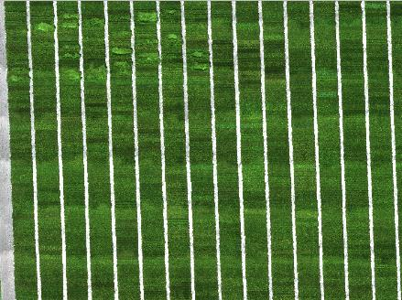
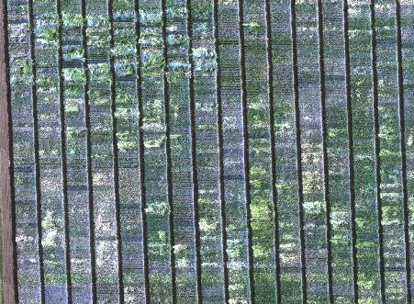
Use of Phenomics
Use of drones to include improve selection
Current testing in yield trials
In coming years expand to early generations
Lodging
progression

Slide 8
Research activities in WW
Strategies to utilize genomics in WW
Genomic selection
Haplotype mapping to understand adaptive genomic regions in Montana WW
Use genetics in improving forage breeding strategies

Slide 9
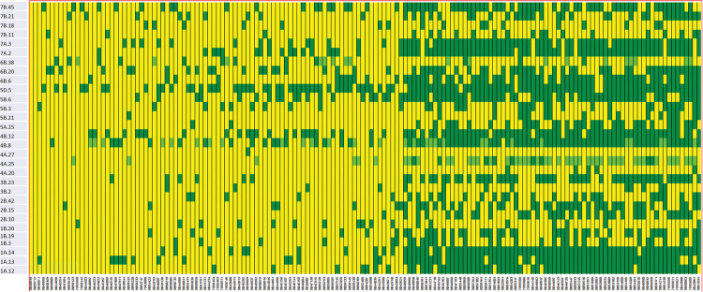
A strategy…..
Example: Green sections show the genomic regions (haplotypes) across lines that are linked to adaptation under heat & drought
(Seghal et al 2020)

Slide 10
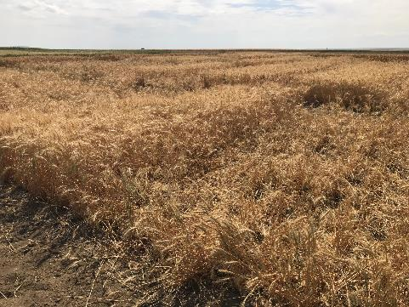
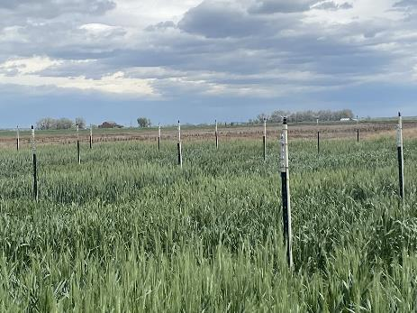
Pest and Diseases Resistance
Selection under Wheat sawfly pressure (WSS) (at NARC, Peggy Lamb)
Selection for Fusarium Head Blight (at SARC, Kent McVay & Frankie Crutcher)

Slide 11
2022 Evaluations and Variety Performance

Slide 12
2022 Winter Wheat Variety Survey (estimated planted % acreage of WW varieties)
Variety | North West | North Central | North East | Central | South West | South Central | South East | Total
Warhorse | - | 35.7 | - | 16.1 | - | - | - | 28.1
Keldin | - | 14.8 | - | 12.4 | - | 8.5 | - | 12.9
Bobcat | - | 14.2 | - | 1.9 | - | - | - | 10.0
Yellowstone | - | 4.8 | - | 9.9 | 16.8 | 2.0 | - | 5.9
Battle AX | - | 4.6 | - | 8.2 | - | - | - | 4.7
Brawl CL Plus | - | 0.6 | - | 16.6 | 19.1 | 14.8 | - | 4.6
Judee | - | 5.2 | - | - | - | 4.0 | - | 3.9
FourOSix | - | - | - | 8.7 | - | - | - | 2.4
LCS Fusion AX | - | 1.5 | - | - | - | - | - | 2.3
Monument | - | - | 19.6 | 2.8 | - | - | - | 2.2
Willow Creek | 22.3 | - | 1.1 | 1.4 | - | 1.7 | 5.7 | 0.7
Ray | - | 0.2 | - | 0.9 | - | - | - | 0.4
Other,Unknown | 77.7 | 10.7 | 79.3 | 10.6 | 34.1 | 64.0 | 94.3 | 12.6

Slide 13
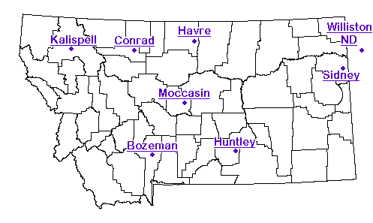
Testing locations
Loma
Turner
In collaboration with Montana Agriculture Experiment Stations in 8 locations and off-station nurseries at each location we conduct our multi-location yield testing
Creston
Ft. Ellis
Denton
Geraldine
Belt
Judith Gap
Rapelje
Hysham
Molt
Fly Creek
Ft. Smith

Slide 14
Performance in Intrastate Yield Trial 2022
49 entries, 3 reps, across 9 locations
Includes released varieties from MSU, private companies, public breeding programs and new lines

Slide 15
Intrastate performance in Kalispell, 2022
MSU variety
Pvt variety
New MSU Lines

Slide 16
Intrastate performance across locations, 2022
MSU variety
New MSU Lines
Pvt variety

Slide 17
Stripe rust incidence
Stripe rust incidence in top grain yield performers
Data from Washington State University
Variety/Lines | % Infection |  |  |  | Infection Type
 | Pullman | Central Ferry | Mt Vernon |  | Pullman | Central Ferry | Mt Vernon
LCS Helix AX | 20 | 40 | 10 |  | 3 | 5 | 2
MTCS20156 | 20 | 5 | 10 |  | 3 | 2 | 2
Keldin | 50 | 60 | 30 |  | 5 | 5 | 3
MT19175 | 20 | 10 | 30 |  | 3 | 2 | 3
SY Clearstone 2CL | 15 | 5 | 10 |  | 2 | 5 | 2
Milestone | 80 | 60 | - |  | 8 | 8 | -
SY Wolverine | 100 | 80 | 10 |  | 9 | 8 | 2
Whistler | 80 | 80 | 90 |  | 8 | 8 | 9
AP Bigfoot | 80 | 70 | 20 |  | 7 | 8 | 3
MT1745 | 10 | 5 |  |  | 2 | 2 | 3
Bobcat | 15 | 5 | 10 |  | 3 | 2 | 2
MT2019 | 5 | 20 | 10 |  | 2 | 2 | 2
Infection Type (IT): scored on 0-9 scale
IT 0-3 resistant
IT 4-6 intermediate
IT 7-9 susceptible
MSU variety
New MSU Lines
Pvt. variety

Slide 18
Preliminary yield trial performance, 2022

Slide 19
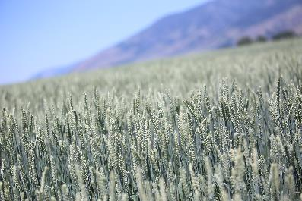
Winter Forage Breeding
Ray
MTF 20189
New lines similar in height to Willowcreek, early heading, similar forage yield and quality, higher seed yield compared to Willowcreek
Released in 2018, shorter than Willowcreek, similar forage yield and quality, superior seed yield

Slide 20
Data from Winter Cereal Forage Nursery, 2021-2022
Variety/Line | Height (in) |  |  |  | Forage Yield (t/ac) |  |  |  | Seed Yield (bu/ac)
 | Moccasin |  | Bozeman |  | Moccasin |  | Bozeman |  | Moccasin |  | Bozeman
 | 2021 | 2022 | 2021 | 2022 | 2021 | 2022 | 2021 | 2022 | 2021 | 2022 | 2021 | 2022
Willow Creek | 30.6 | 33.3 | 43 | 56.9 | 1.9 | 3.2 | 5.1 | 8.7 | 35.7 | 17.4 | 44.4 | 69.3
Ray | 28.1 | 27.2 | 34.2 | 44.8 | 2.0 | 2.4 | 5.2 | 8.2 | 49.7 | 31.1 | 52.1 | 92.3
MTF 20189 | 34.2 | 35.9 | 45.9 | 55.5 | 2.7 | 3.1 | 6.1 | 7.9 | 52.1 | 33.8 | 50.7 | 80.7
LSD | 1.8 | 3.54 | 1 | 2.5 | 0.5 | 0.53 | 1 | 1.5 | 10.7 | 7.0 | 6.08 | 16.5
CV | 4 | 9.56 | 12.5 | 2.8 | 15 | 18.11 | 12.5 | 10.8 | 16.3 | 3.95 | 8.1 | 20.3
p-value | <0.01 | <0.01 | <0.01 | <0.001 | 0.03 | <0.01 | 0.03 | 0.54 | 0.01 | 0.012 | <0.01 | 0.0003
No significant difference in protein, ADF or NDF values between the lines

Slide 21
Acknowledgements
Montana Agriculture Experiment Stations
Darrin Boss
Jessica Torrion (NWARC)
Clint Beiermann (NWARC)
Jessica Pavelka (NWARC)
Daniel Porter (NWARC)
Peggy Lamb (NARC)
Patrick Carr (CARC)
Jed Eberly (CARC)
Jennifer Hammontree (CARC)
McKenna Volkman (CARC)
Dave Gettel (Bozeman)
Ken Kephart ( SARC - retired)
Kent McVay (SARC)
Qasim Khan (SARC)
Chengci Chen (EARC)
Frankie Crutcher (EARC)
NDSU Williston Extension Research Center, North Dakota
Gautam Pradhan
Winter Wheat Breeding Program Phil Bruckner (retired)
Ron Ramsfield
Jim Berg (retired)
Duncan Pantos
Foundation Seed Program
Doug Holen
BranDee Johnston

