Slide 1
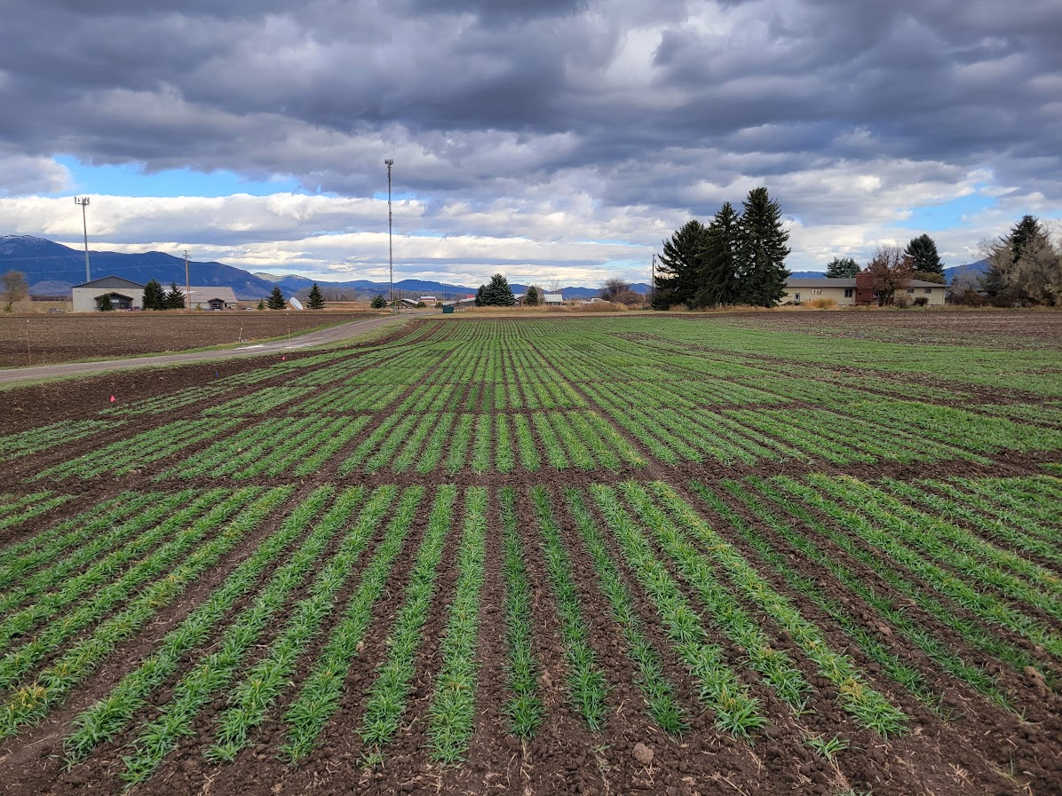
Winter barley for Montana, making a dream a reality
Notes:
The photo on the right was taken November 3rd not long after that early cold spell.

Slide 2
BPI

Slide 3
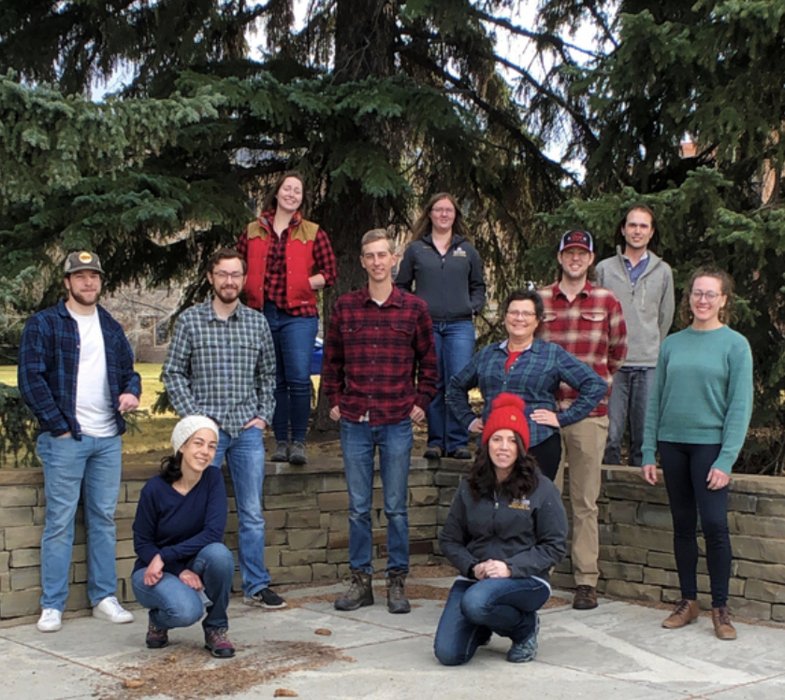
MSU Barley Breeding, Genetics and Quality
Jamie Sherman
Hannah Turner
Greg Lutgen
Traci Hoogland
Sarah Olivo
Graduate Students
Joe Jensen
Jessica Williams
Trevor Palone
Aline Brito (visiting)
Undergraduates
Grace Aisenbrey
Katelin Aisenbrey
Cody Crowley
Shelby Duncan
Parker Erikson
http://www.montana.edu/barleybreeding
facebook @MSUBarleyMaltQualityLab/

Slide 4
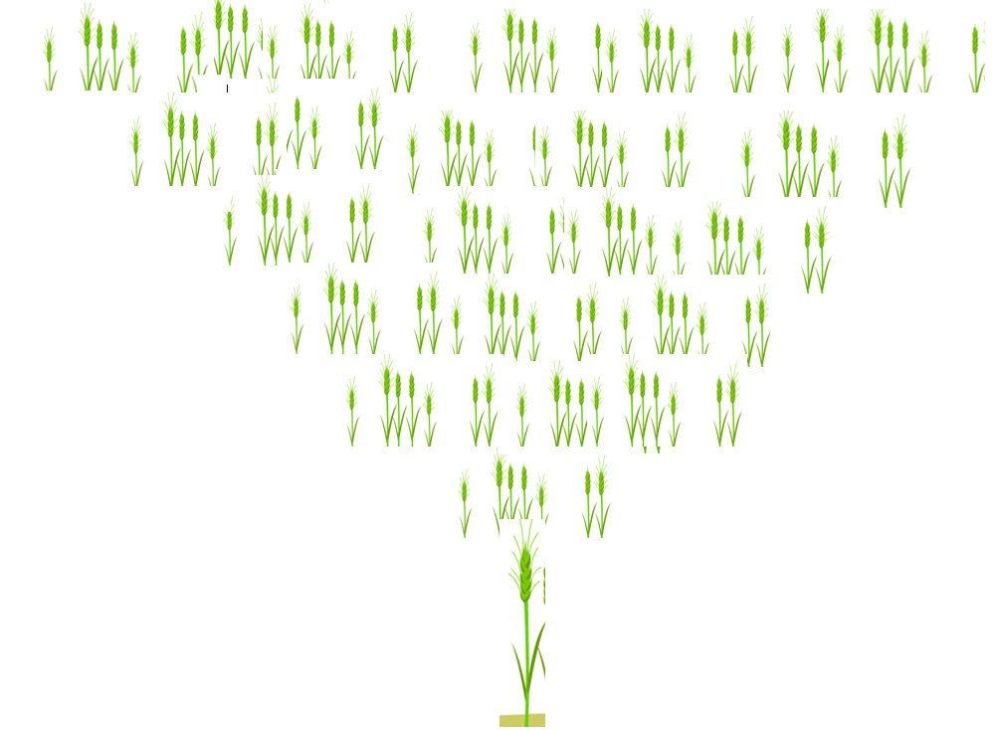
Y 1 make crosses & inbreed 1 generation
Winter breeding – longer process than spring crops
Y2
Y3
Y4 select best plants
Y5 test plant rows
Y6 test full plots
Y7, 8 and 9 full plots around the state
Spring crops can be inbred 3X faster.
Effectiveness of selections depends on number of location years
MSU requires a minimum of 11 location years
Y10, 11, 12 make enough seed for release

Slide 5
Winter Barley timeline
2018 – Acquired Vavilov lines and screened
2019 – started crosses and examined tilled vs no-till
2020 – evaluated OSU material for more winter hardiness and implemented it into crosses
2021 – First full plot trials of MSU crosses (Malt/Feed PYT)
2022 – Started Malt/Feed Intra and Forage Intra
2023 – Lost the majority of our locations due to abnormal weather
2024 – testing Malt/Feed in 3 locations and Forage in 6
2025 – Enough location years to release 1 Feed and 1 Forage line

Slide 6
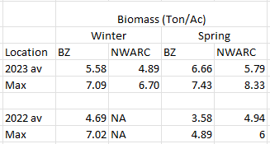
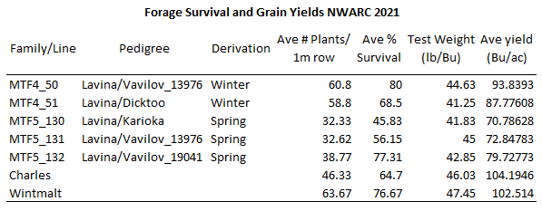

Slide 7
We have improved winter survival

Slide 8
State-wide forage trials

Slide 9
State-wide feed trials

Slide 10
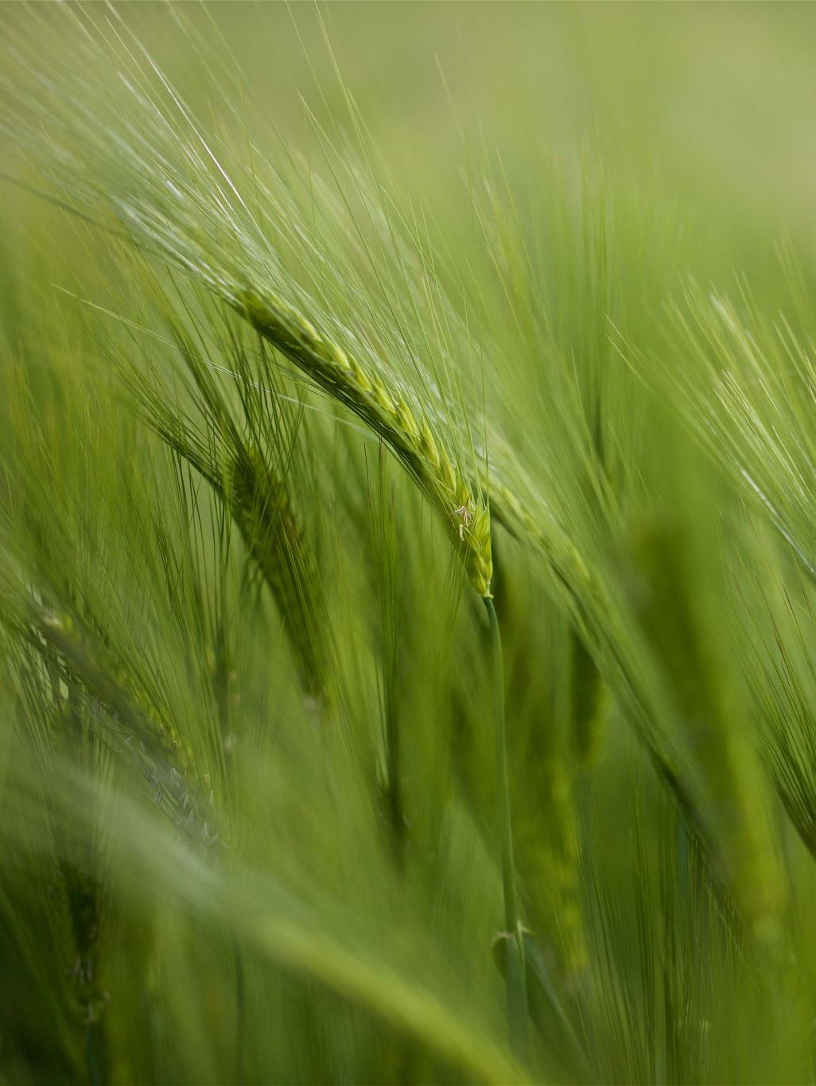
Future Goals
Identify the optimal planting date
Resiliency initiative
Grazing winter barley
Identifying place in rotations
Develop and Release new varieties

Slide 11
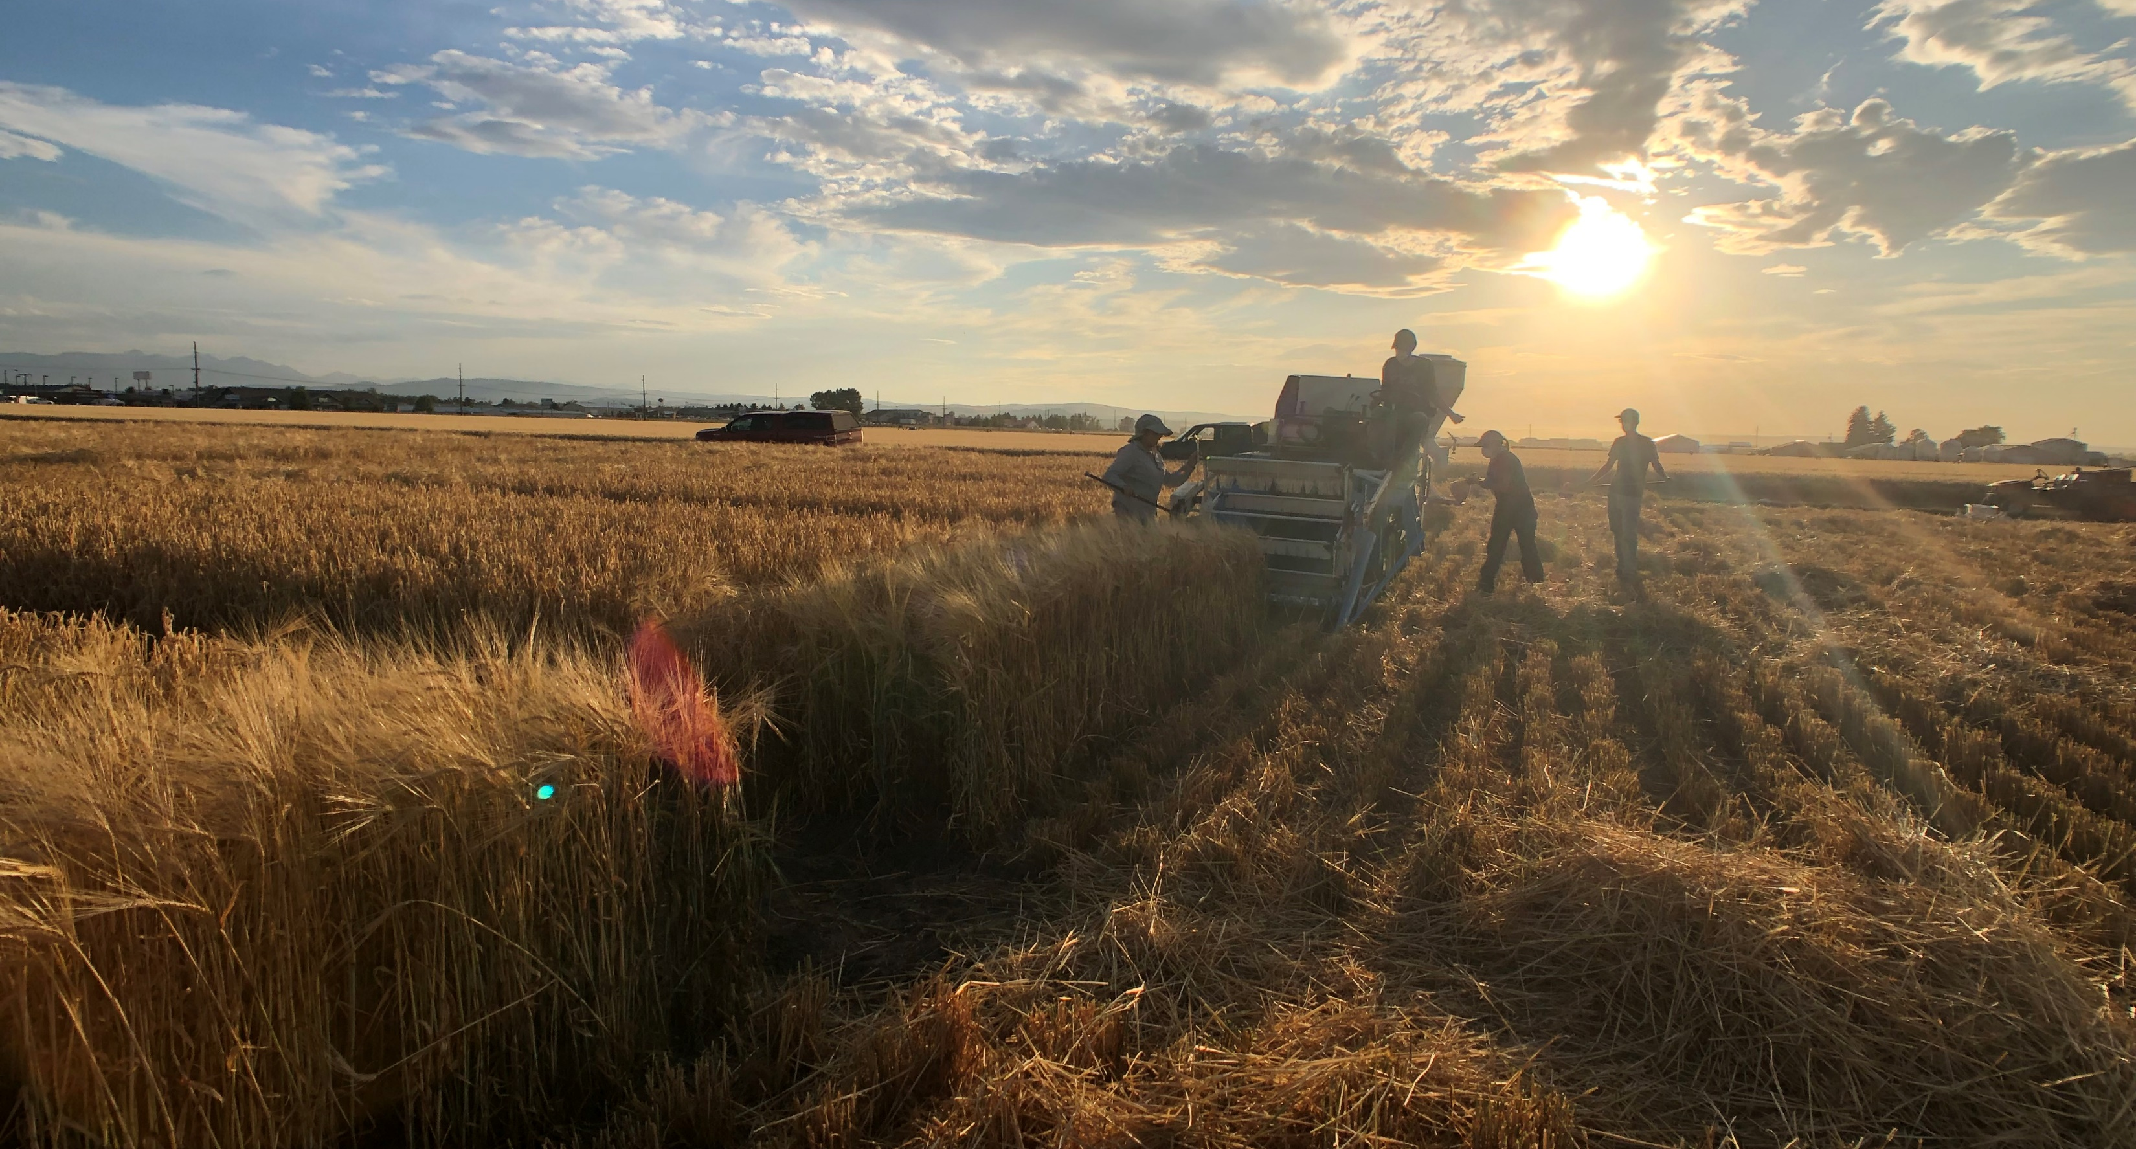
Questions?
Phone: 406-366-9010 Email: joseph.jensen4@student.montana.edu

