Slide 1
Managing elite spring wheat cultivars in Montana
Jessica A. Torrion
Jessica.torrion@montana.edu; 406-755-4303
Jason Cook
Justin Vetch

Slide 2
Slide Source: Jason Cook – PSPP Spring Wheat Breeder

Slide 3
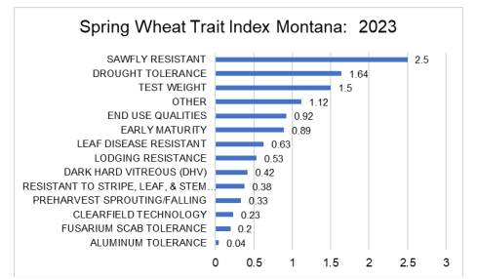

Slide 4
Background
Drought – High ambient temperature and low rainfall
$1.1/lb N + $0.5/lb seed tech
Yield, quality, & income implications

Slide 5
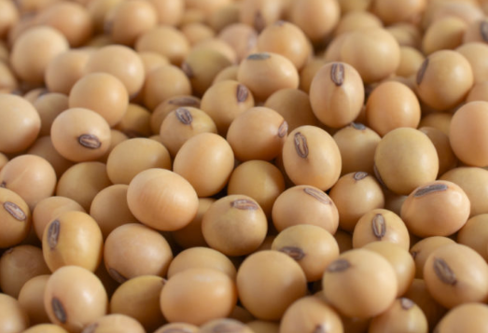
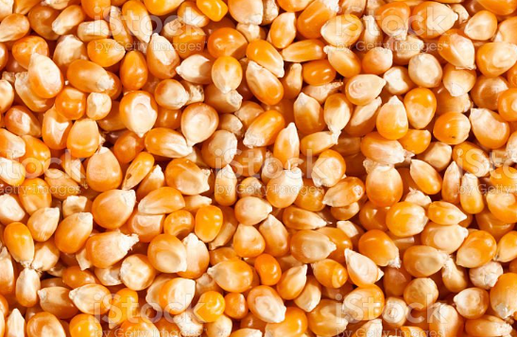

Slide 6
Objectives
Evaluate if we can reduce N and seed inputs without negatively impacting yield and quality.

Slide 7
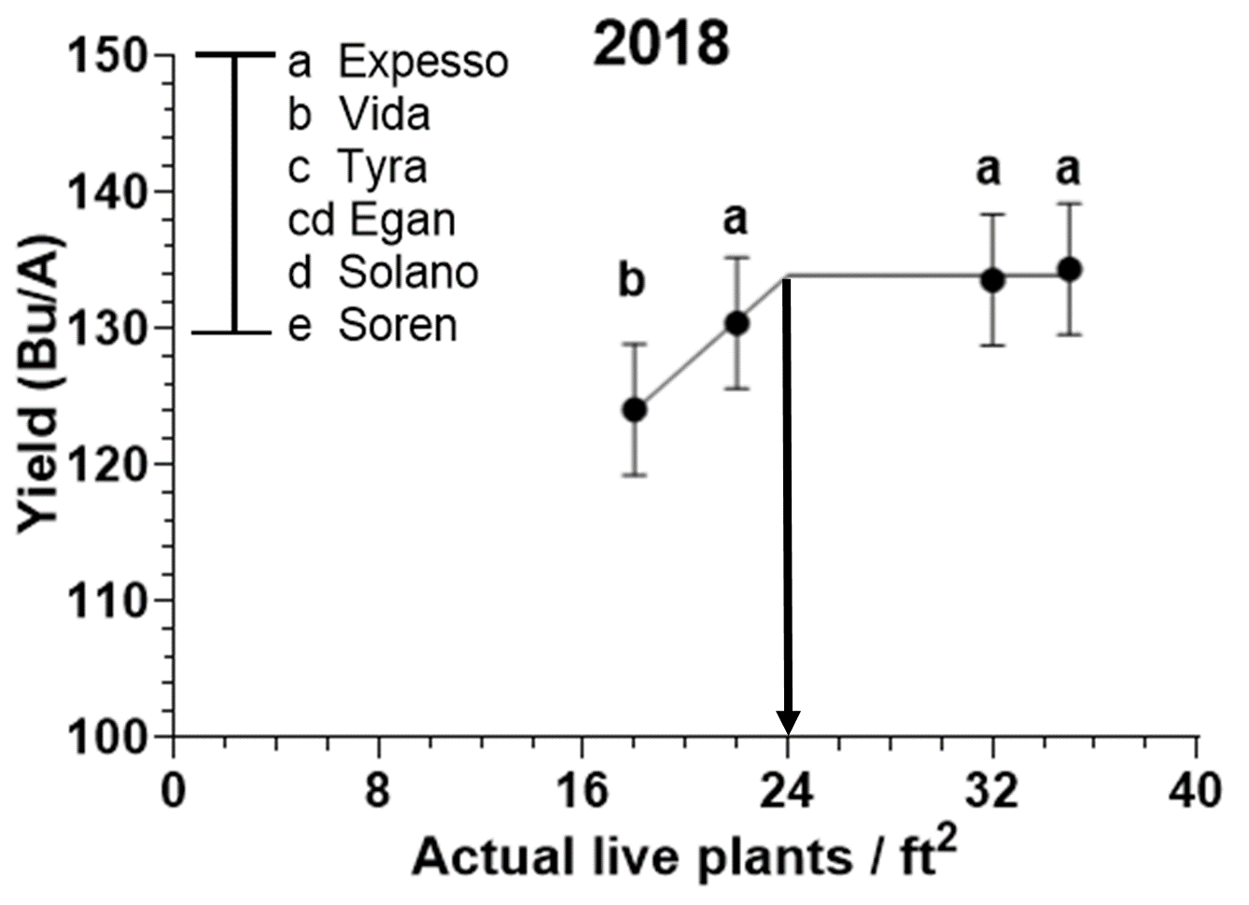
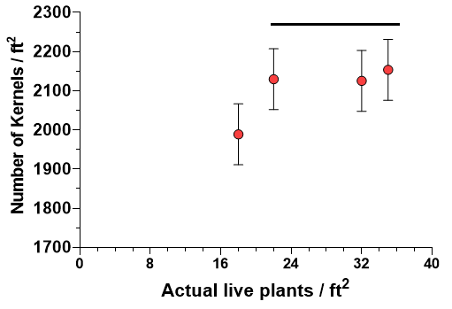
In 2018

Slide 8
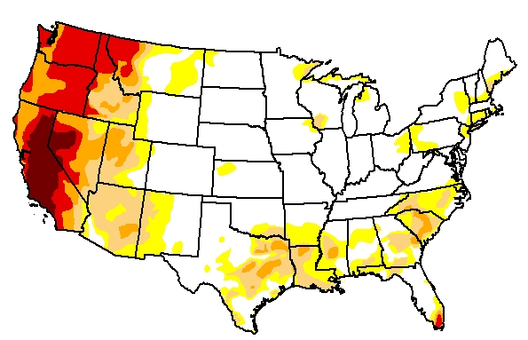
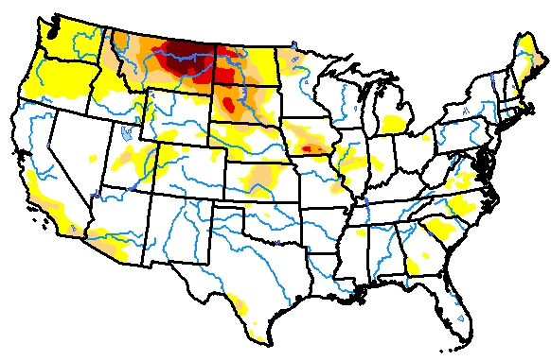
2015
2017
2021
seeding rates (live seeds from 16, 24, 32, & 40 per ft²) had the same yield.
Source: U.S. Drought Monitor

Slide 9
Egan
Gpc-B1; midge resistant
Dagmar
Semi-solid stem, sawfly
Montana State University
MT Sidney
Fusarium head blight
Vida
Stay-green
Sy Ingmar
High protein (Syngenta)

Slide 10
2023
Main plot, Total Nitrogen
200, 150, & 110 lbs/Ac
High, medium, & control
Subplot, Five elite cultivar
Dagmar, Egan, MT Sidney,
Sy Ingmar, & Vida
Sub-subplot, three seeding
12, 18, 24 live seeds/ft²

Slide 11
https://halross.com/product/wheat-250-count-seed-ruler/
69 $CAN
Varieties | 1000 Seeds (g) | ---------------lbs/acre-------------- | lbs/acre---
 |  | 24 seeds/ft2 | 18 seeds/ft2 | 12 seeds/ft2
Dagmar | 38.9 | 92 | 69 | 46
MT Sidney | 19.1 | 45 | 34 | 22
Egan | 40.3 | 94 | 70 | 47
Vida | 33.6 | 80 | 60 | 40
SY Ingmar | 32.5 | 80 | 60 | 40

Slide 12
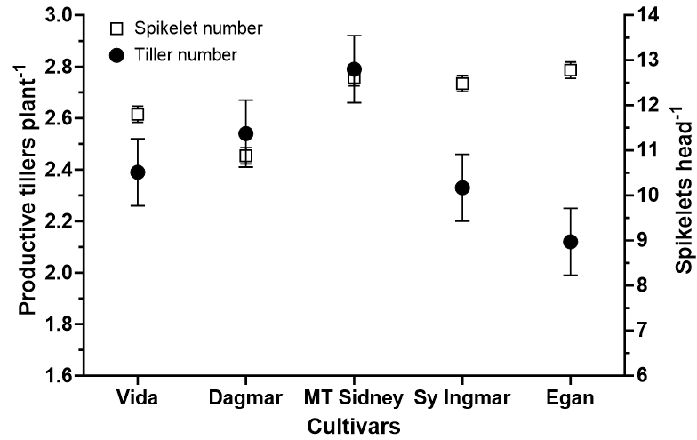

Slide 13
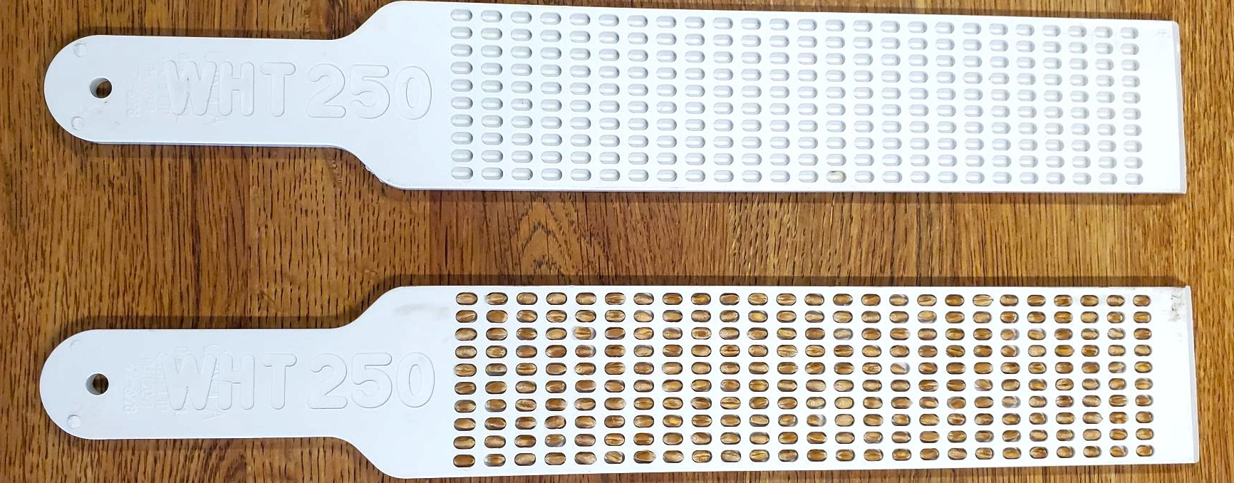
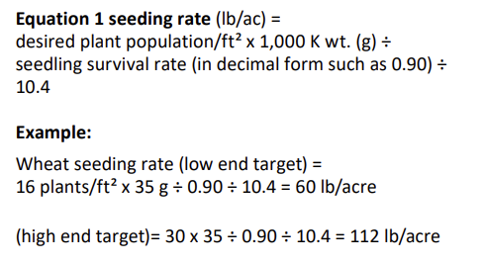
https://halross.com/product/wheat-250-count-seed-ruler/
$69 CAN/pc
https://www1.agric.gov.ab.ca/$department/deptdocs.nsf/all/agdex81/$file/100_22-1.pdf

Slide 14
Methods

Slide 15
Yields were the same for the Nitrogen levels at 200, 150, & 110 lbs/Ac

Slide 16
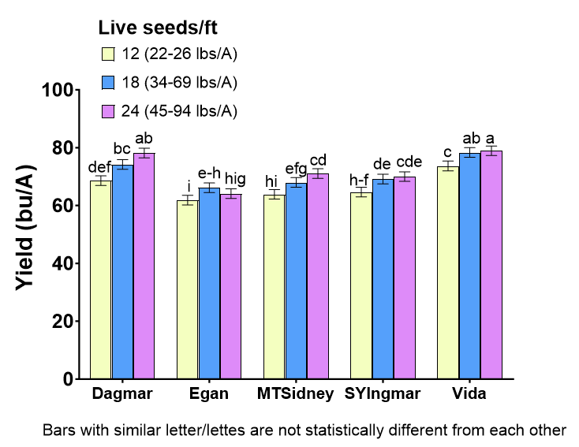
Significant interaction between seeding rate x varieties

Slide 17
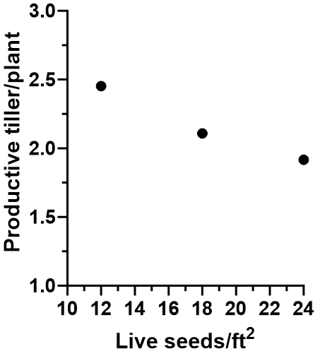

Slide 18
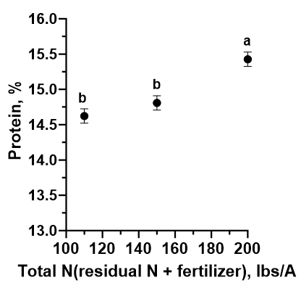
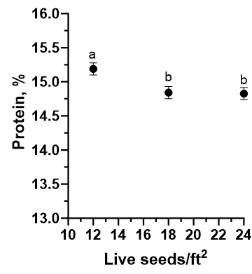
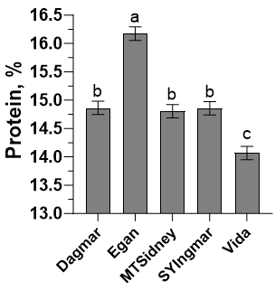
Protein

Slide 20
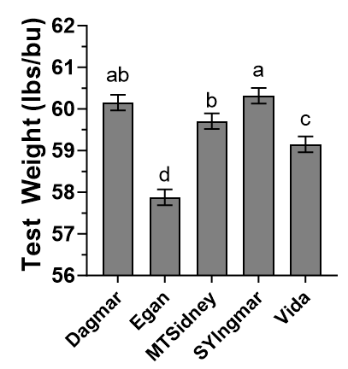
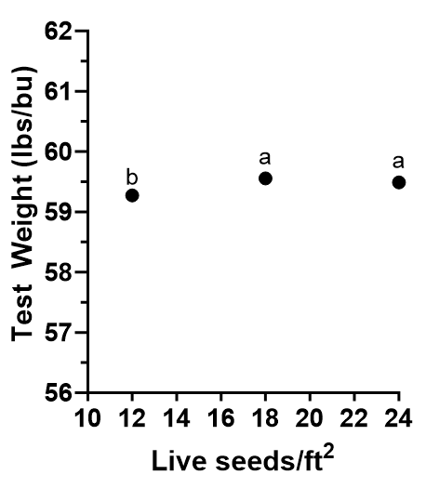
Test Weight
Typically, test weight >60 during cool/rainy season

Slide 21
2022 – Cool and more rain

Slide 22
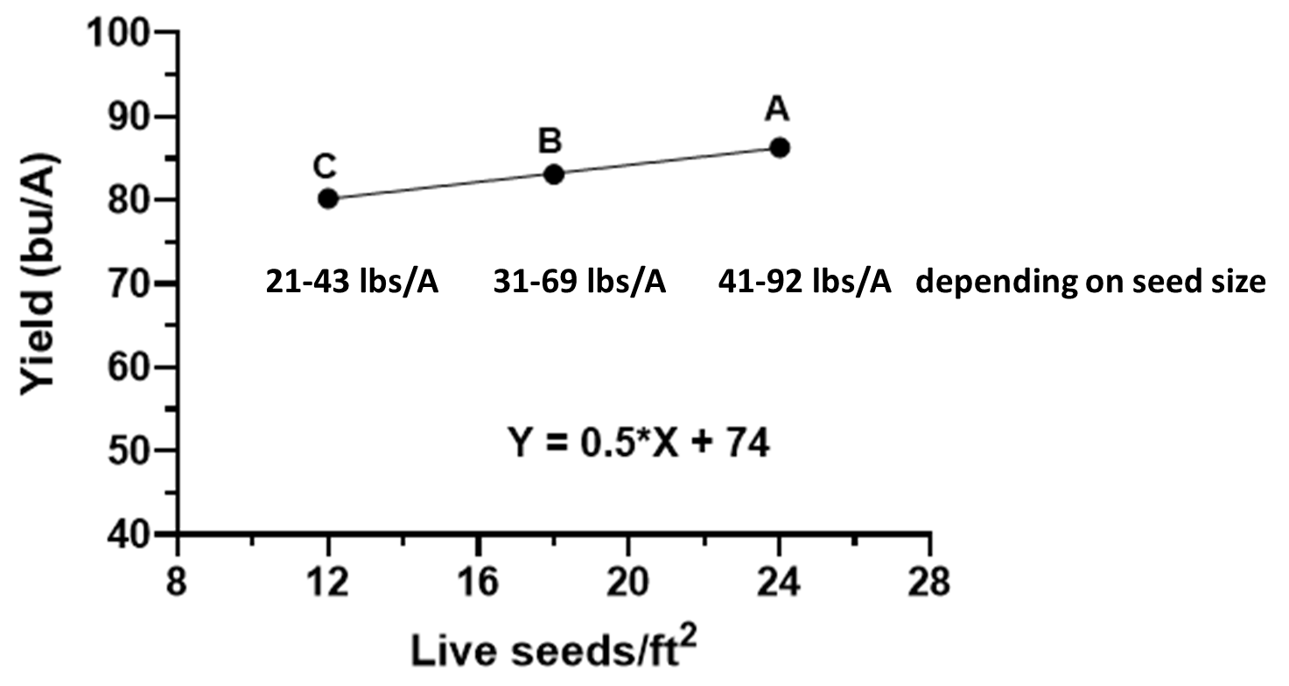

Slide 23
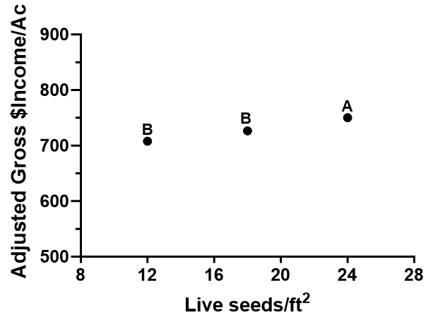

Slide 24
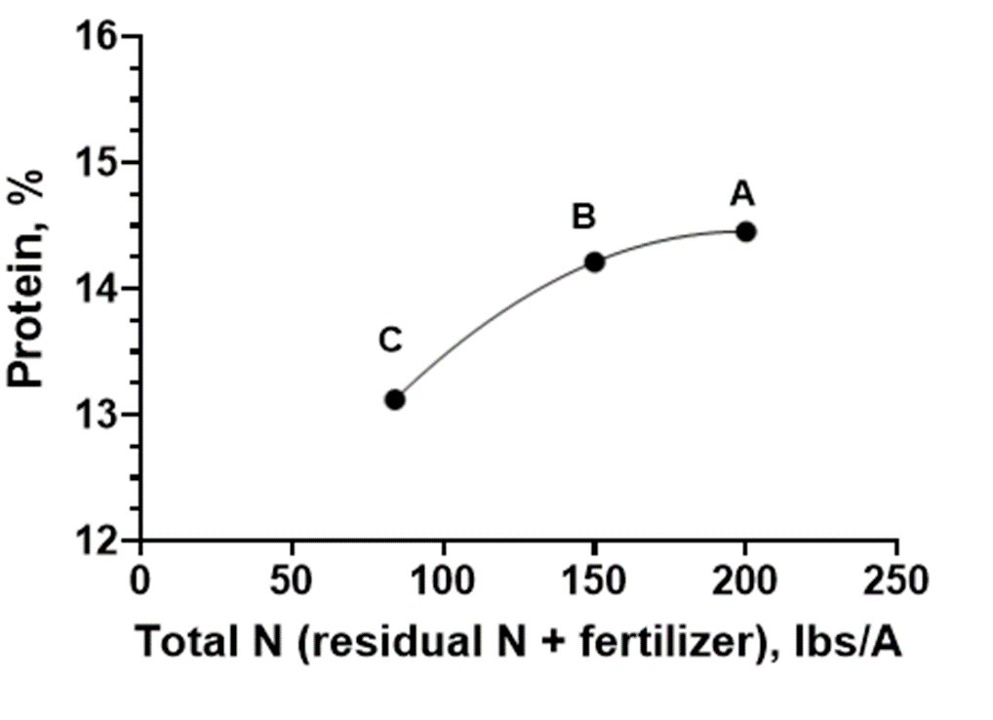

Slide 25
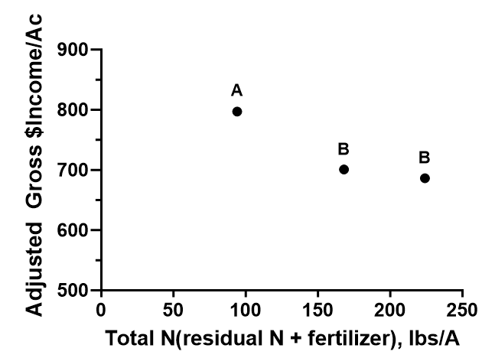

Slide 26
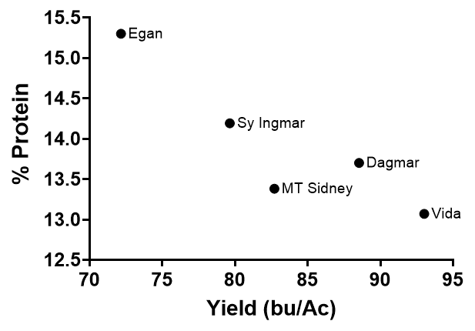

Slide 27
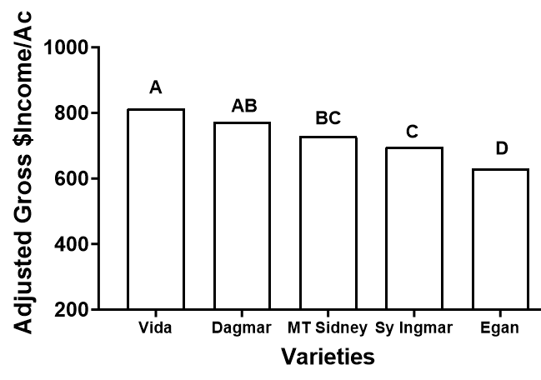

Slide 28
Takeaway
Staying below 200 lbs total N (residual + applied). We stay around 150 total N for spring wheat
Seed size matters in planning your seeding rates. Live seeds above 24/ft² are already economically risky.
Planting below 24/ft² is acceptable – wheat tillers more with a lower population.
During drought, test weight is problematic. Dagmar, SY Ingmar or MT Sidney (based on 2023 research) had superior test weights.

Slide 29
