Slide 1
Why didn’t my pesticide work?
Cecil Tharp, PH D
MSU Pesticide Education Specialist
Bozeman, Montana

Slide 2
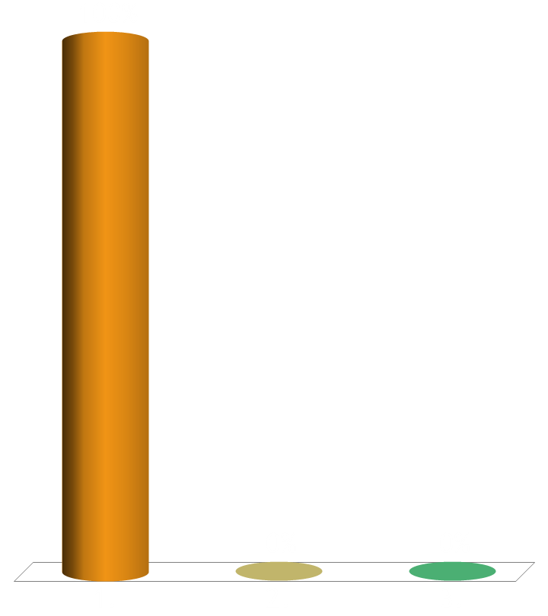

Do you get poor results occasionally from pesticide applications?
Yes
No
Not sure

Slide 3
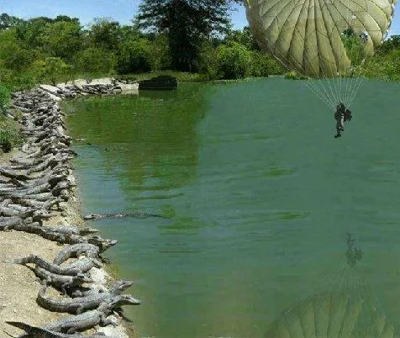
Poor Results Can be Frustrating
Understanding Product Label
Calibration
Environmental Conditions
Water Quality
Timing

Slide 4
Understanding Product Label
Site must be listed
The pest should be listed
Screen label for ideal timing, required rates
Required output (GPA)
Use surfactants if not prohibited. Non-ionic surfactants usually a good go-to unless prohibited.

Slide 5
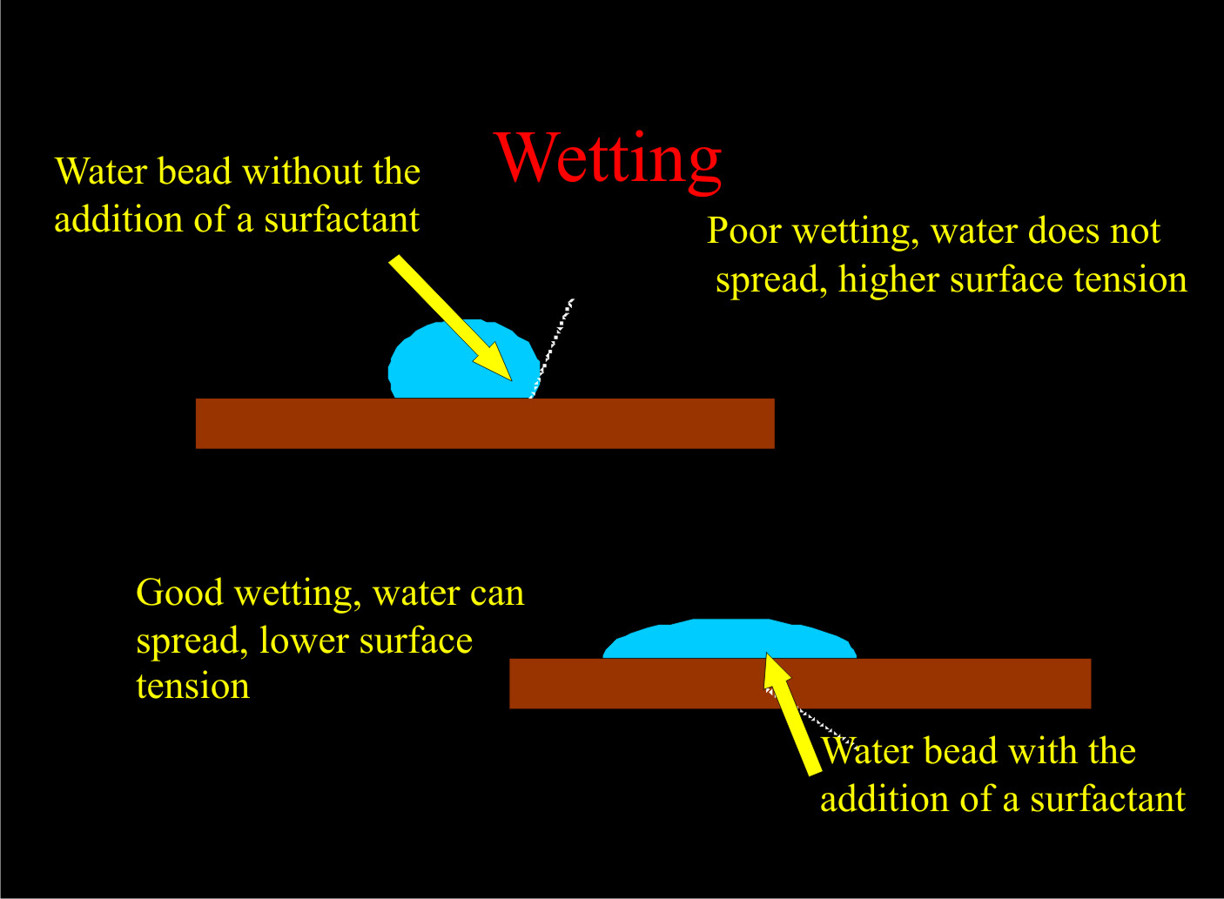
Adjuvant
Surfactants, drift reduction agents (i.e. InterLock), emulsifiers, spreader stickers, crop oils, penetrants, anti-foaming materials, and compatibility agents.

Slide 6
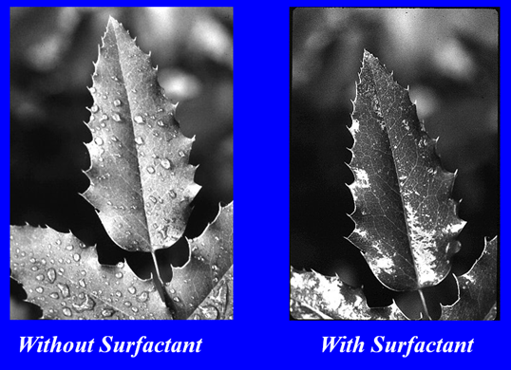
Surfactants
A broad category of adjuvants that facilitate and enhance the absorbing, emulsifying, dispersing, spreading, sticking, wetting and penetrating properties of pesticides.
Some pesticides like Roundup Pro already have surfactants added. (14.5 %)

Slide 7


Do you use surfactants to boost efficacy?
Yes
No
Sometimes

Slide 8
Types of Surfactants
- Nonionic Surfactants (no charge)
  This class of surfactant reduces surface tension and improves spreading, sticking and herbicide uptake.
  All purpose
- Silicone compounds (Silicone based)
  More reduction in surface tension.
  Spread more than conventional surfactants
  Maximum rain-fastness due to increased absorption.
  Can usually use at lower rates
  Basagran; Blazer; Cobra; Glaxy; Storm

Slide 9
Oil Surfactants
Crop Oil Concentrates (COC)
  Blend of paraffin-based petroleum oil and surfactants; not good spreader in comparison
  Used primarily with grass herbicides (Poast; Select; atrazine)
  Tolerance can be a problem with crops.
Esterified Seed Oils (ESO) often referred as MSO
  Comprised of a methyl or ethyl ester of a vegetable seed oil (sunflower, soybean, corn, canola) combined with a surfactant/ emulsifier. These spray solution additives have good spreading and pest penetrating properties and convey good crop tolerance.
  More expensive than vegetable seed oils or crop oil concentrates.
  All purpose
  Accent; Beacon; Pursuit

Slide 10
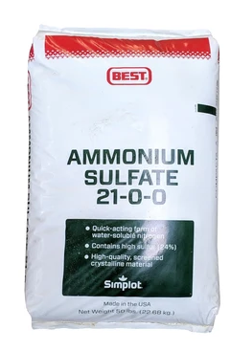
Surfactant Blends: AMS and other Fertilizers
Fertilizers with NIS: Improves herbicide uptake with hard to-kill weeds
AMS with NIS: Neutralizes or gives hard water mineral ions something to bind to instead of the herbicide.

Slide 11
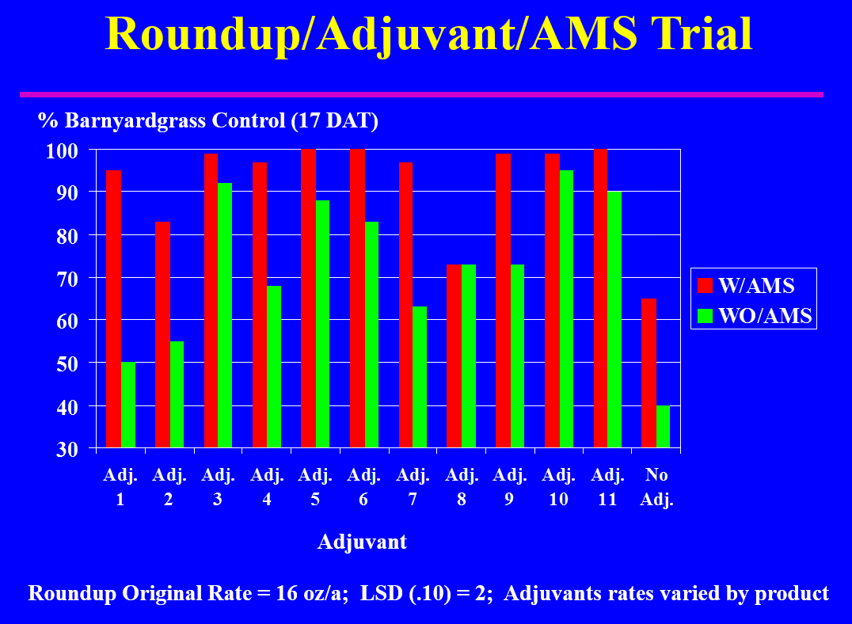
NDSU Field Trials

Slide 12
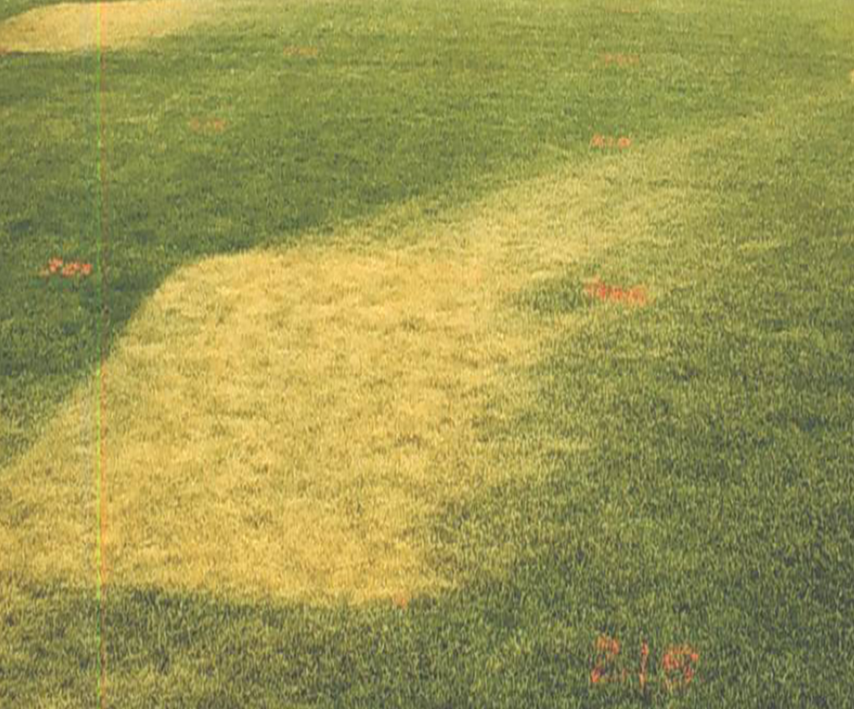
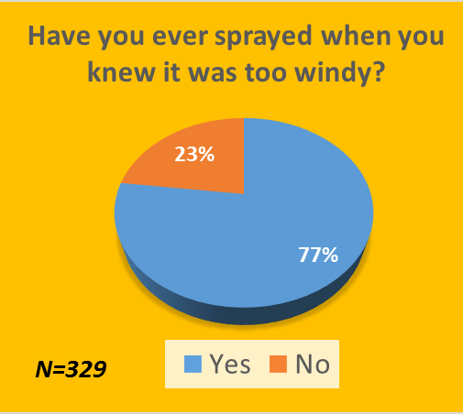
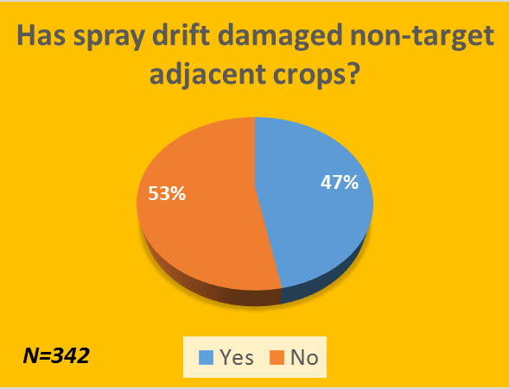
Drift can reduce efficacy

Slide 13
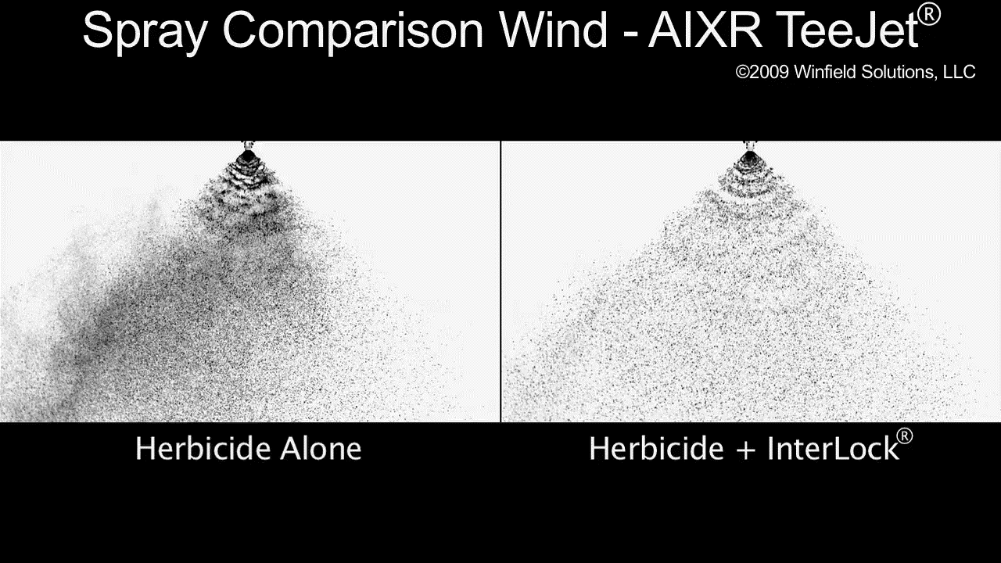
Drift Reducing Agents
Often change the viscosity enlarging the spray droplet
InterLock is proven to decrease driftable fines by 50-70% across all nozzle types.

Slide 14
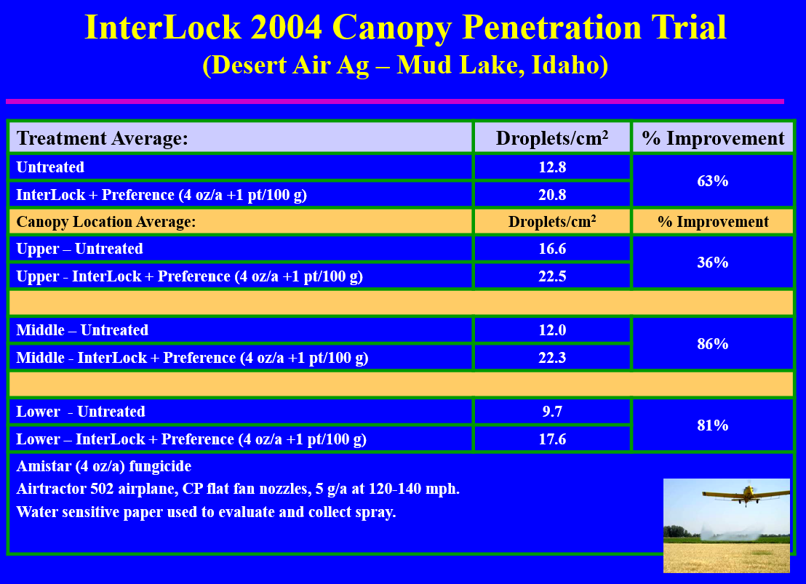
Deposition Aids
Also known as drift retardant. They vary by nozzle technology and spray adjuvant used.
InterLock is a good all around deposition aid.

Slide 15
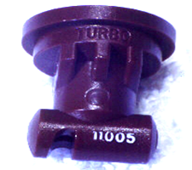
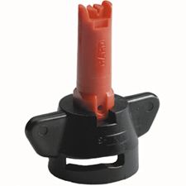
Drift Reduction
Have you ever sprayed when it is over 10 mph?
Consider using drift reduction technologies
  Chamber orifice design (i.e. Turbo TeeJet)
  Air Induction Nozzles
Drift reducing adjuvants
  Beware of snake oil
  Vary in effectiveness towards nozzle technology
  Read specific recommendations as to which type of nozzles they are effective
  A few work on a wide range of nozzle types (InterLock)

Slide 16
Do you test your water quality prior to tank mixing?
Yes
No
Sometimes

Slide 17
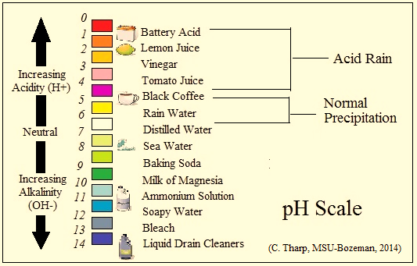
The impact of water quality. What is pH?
The measure of the concentration of hydrogen ions (H+) and hydroxide ions (OH-) in a solution.
Scale is logarithmic: 0 - 14
  Hydrogen ions predominate (acidic < 7)
  Hydroxide ions predominate (alkaline > 7)
Notes:
pH is the measure of the concentration of positively charged hydrogen ions and negatively charged hydroxide ions in a solution. The pH scale is logarithmic scale from 0 – 14 where a pH of 7 is neutral.
-if hydrogen ions predominate than the pH < 7 and termed acidic
-if hydroxide ions predominate than the pH > 7 and is termed a an
alkaline solution.
Distilled water is an example of a neutral solution. Some examples of an acidic solution would be Lemon Juice with a pH of 2.0, Vinegar with a pH of 3, and Black Coffee with an approximate pH of 5.0. Some examples of an alkaline solution would be baking soda with a pH of 9.0, Milk of Magnesia with a pH of 10.0 and ammonia with a pH of 11.

Slide 18
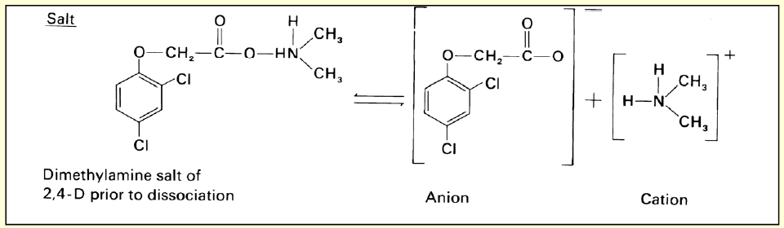
Pesticide Dissociation
Dissociation is the breaking down of a complex molecule into simpler units.
Efficacy often goes down when molecules are broken into subunits. Plants often won’t absorb the chemical as well.
  pH 4 – 7 is ideal for most pesticides.
Notes:
Acid and alkaline solutions may cause pesticide dissociation depending on the pesticide used. Dissociation is the breaking down of a complex molecule into simpler units. These simple units reduce efficacy due to limited absorption into plants.
Low pH, acid solutions breakdown alkaline pesticides; while high pH alkaline solutions breakdown acid pesticides.
pH 4 – 7 is ideal for most pesticides as most pesticides are neutral or are weak acid chemistries. The weak acid 2,4-D amine pesticide molecule that you see here is easily broken into simple subunits in a high pH solution (pH > 7.0). These subunits are not easily absorbed by plant; thus lowering efficacy of the product.

Slide 19
Dissociation through
Alkaline Hydrolysis
Weak Acid herbicides as well as many fungicides and insecticides are susceptible to alkaline (pH>7) hydrolysis
  Glyphosate (Ex. Roundup®)
  ammonium salt of imazethapyr (Ex. Pursuit®)
  glufosinate ammonium (Ex. Liberty®)
  2,4-D salt (amine) products
  Organophosphate insecticides (ex. Malathion)
  Carbamate insecticides (ex. Carbaryl)
  Many pyrethroid insecticides
  Many fungicides (ex. Benomyl, chlorothalomil)
Notes:
Alkaline hydrolysis is a break down of a pesticide in an alkaline solution. Weak acid herbicides, as well as many fungicides and insecticides are susceptible to alkaline hydrolysis. Some pesticides susceptible to alkaline hydrolysis include:
-glyphosate
-ammonium salt of imazethapyr
-glufosinate ammonium
-2, 4-D salt (amine)
-malathion and other organophosphate chemistries
-carbaryl and other carbamate chemistries
-some pyrethroid insecticide chemistries
-benomyl, chlorothalomil and other fungicide chemistries

Slide 20
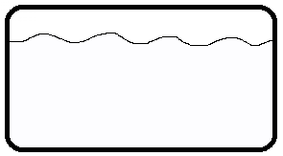
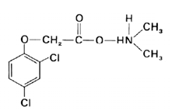

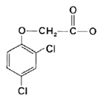

Pesticide Breakdown (Dissociation) in High pH Solutions by Alkaline Hydrolysis
Pesticide Spray Tank
Subgroups not
absorbed as easily
High pH Solution
2,4-D amine
Dissociation
+
=
+
Anion (-)
Cation (+)
Notes:
This animation will display how a 2,4-D amine molecule is broken down in a high pH solution.
This is an intact 2,4-D amine molecule that works as effectively as possible at controlling pests. When this pesticide is exposed to a high pH solution efficacy can be reduced.
Over time the high pH solution will cause a break in the pesticide molecule that you see here. This is alkaline dissociation also known as alkaline hydrolysis.
Dissociation causes the intact pesticide molecule to be broken into an negatively charged-anionic and positively charged-cationic subgroup that are not easily absorbed by the target plant.

Slide 21
Hardness of Solution
Hardness is the measure of + charged (cation) minerals
Measured in ppm
Cat-ionic minerals bind with negatively charged pesticide molecules
Most hardness kits measure Ca²⁺ and Mg²⁺
Positively Charged Cations
Aluminum (Al ³⁺)
Iron (Fe²⁺, Fe³⁺)
Magnesium (Mg²⁺)
Calcium (Ca²⁺)
Sodium (Na¹⁺)
Notes:
TDS can give applicators an overall idea of a potential problem with water quality but mitigation strategies vary depending on the exact types of minerals in the water.
Due to this many applicators choose to assess the hardness of water rather than TDS. This is because hard water can cause a variety of problems for the pesticide applicator.
Hardness is the measure of positively charged minerals in water. Positively charged minerals are called cationic minerals and are measured in parts per million. Hardness can also be expressed as grains per U.S. gallon where one grain per gallon = 17.1 ppm.
Cat-ionic minerals bind with negatively charged pesticide molecules; thus rendering many pesticides inert.
Most hardness kits measure only calcium and magnesium but hardness can be attributed from aluminum, iron and sodium.

Slide 22
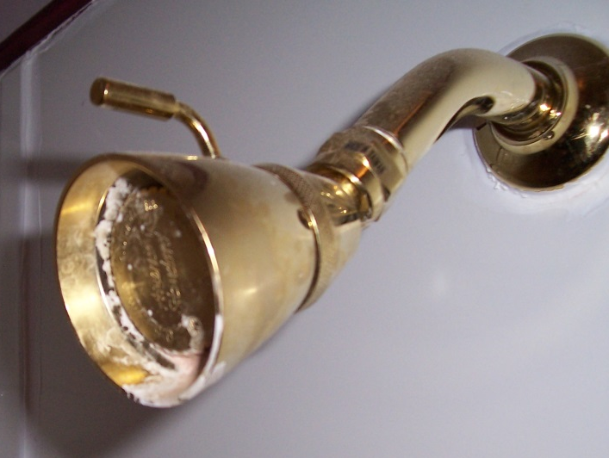
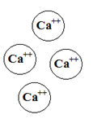
Hard Water and Pesticides
  Positively charged pesticide molecules are often split into negatively charged subunits through alkaline hydrolysis
  Subunits bind with positively charged minerals further
  pH and hardness work together to reduce efficacy
  May produce insoluble salts
+
2,4-D amine sub-
group after hydrolysis (- charge)
Hard Water Solution + (charge)
Notes:
pH and hardness work hand in hand to deactivate a pesticide molecule.
Most weak acid pesticides carry a positive charge when in tact; however once a pesticide molecule splits due to alkaline hydrolysis it converts to a negatively charged sub-unit. These negatively charged sub-units bind with positively charged minerals to further render the pesticide inert.
This often produces insoluble salts that plants can’t absorb. Pesticide application equipment or shower heads that have a white residual is a sign of hard water. This white residual is a build up of calcium or calcium carbonate. Calcium is the most common mineral that leads to hardness issues.

Slide 23
Hardness Ranges
Parts Per Million (ppm) | World Health Organization Classification
0 – 114 | Soft
114 – 342 | Moderately Hard
342 – 800 | Hard
> 800 | Extremely Hard
Notes:
The world health organization classifies hardness into 4 separate categories.
-Hardness ranges between 0 and 114 would be considered soft and wouldn’t pose a problem.
-Hardness ranges between 114 and 342 would be considered moderately hard and cause problems for many weak acid pesticides.
-Hardness ranges between 343 and 800 would be considered hard and cause significant problems for all weak acid pesticides and some select pesticides.
-Hardness ranges above 800 parts per million can be problematic for a wider range of pesticides and should be mitigated.

Slide 24
When is hardness a concern?
Varies by formulation:
  -If > 150 ppm & pH > 7 then mitigation may be needed with many weak acid herbicides
  -Always read product label
Following are susceptible to pH and hardness:
  -2,4-D amine -Imazethapyr
  -Dicamba -Glyphosate
  -Clopyralid
Notes:
pH and hardness often work hand in hand to lower efficacy. Theoretically you may not need to treat moderately hard water if the pH is neutral. However, high pH and hard water can occur simultaneously as minerals in the water can impact pH.
A general rule of thumb is to treat water if greater than 150 parts per million hardness and the pH is greater than 7 when using weak acid pesticides. This includes 2,4-D amine, dicamba, glyphosate, clopyralid and imazethapyr. formulations.
Glyphosate efficacy is reduced at concentrations as low as 150 ppm; while 2,4-D amine formulations have been shown to be totally deactivated at 600 ppm hardness.
Always read the product label for more information as this training module doesn’t account for all pesticides on the market.

Slide 25
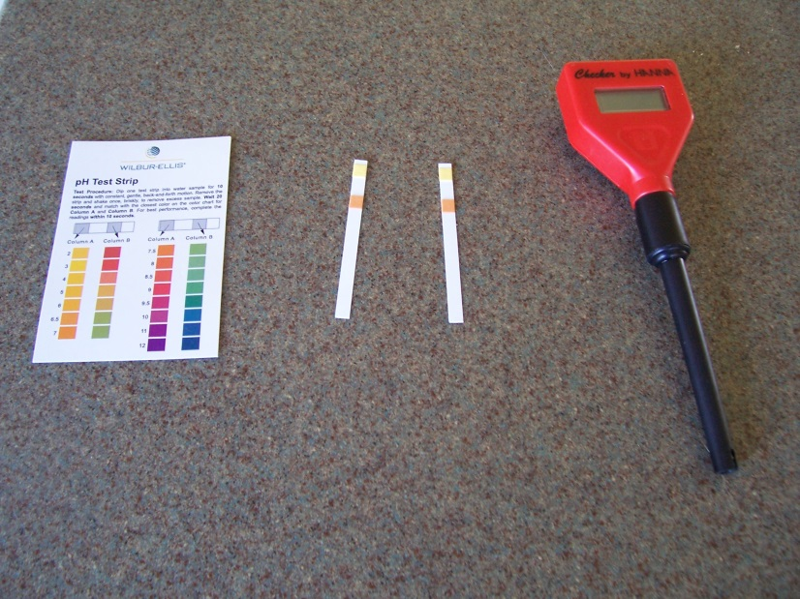
Measuring TDS or Hardness
-Send water sample to water quality lab or test yourself
-Digital devices that measure pH, TDS or hardness may cost from $50 - $300
  -Calibration key
  -Very precise
-Litmus strips provide a pH range but are inexpensive
  -Can test pH, TDS, hardness, sodium or bicarbonates
  -$10 - $30
Notes:
Pesticide applicators should take steps to assess their water quality sources prior to a pesticide application.
Pesticide applicators may send a water sample t o a local water quality testing laboratory or test the water themselves.
Digital devices are available to quickly assess TDS or hardness. These devices range from $50 to $300.
Digital meters are more expensive than litmus strips and need to be re-calibrated periodically; but they deliver precise measurements quickly.
Litmus strips are inexpensive and can test pH, TDS, hardness, sodium or bicarbonates. Some litmus strip kits will measure all units simultaneously on one litmus strip. Litmus strips provide a pH range which is less precise than digital instruments but they will not need to be calibrated.

Slide 26
Do you calibrate all your pesticide equipment at least annually?
Yes
No
Sometimes but not annually

Slide 27
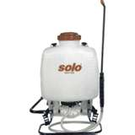
Calibrate your sprayers!
When do you calibrate more than once per year?
Use spray management valves.
Keep the calibration technique / factors consistent with your spray application.
Don’t assume you can’t calibrate hand sprayers, or it is a waste of time.
Notes:
Hand-sprayers can be coarsely calibrated using a few simple steps. Equipment should be cleaned properly prior to calibration. If sprayer cleanliness is unknown, applicators should take time to clean equipment prior to calibration using heavy detergent and water. Once cleaned applicators can fill spray tank with clean, fresh water. Applicators should pressure up tank and inspect for leaks and loose fittings prior to use. This is the time to inspect the sprayer for drips, cracked tanks, replace nozzles, filters, etc… Once passing inspection, applicators can follow a few simple steps to calibrate the handsprayers.
An 18 ½ by 18 ½ area should be marked using flags, marking paint, or tape on an area that mimics your target area. If spraying in high grass, your test strip should be the same as well. This will eliminate any variance due to target differences. Prior to spraying applicators should take some time to assess spray pattern on concrete or gravel to ensure that it is even, desired distance off spray canopy, and whether the nozzle needs to be replaced, or cleaned. While timing, spray plot at constant speed and pressure using gentle arcs at the proper distance off the spray canopy. Applicators must keep pressure constant. This can be difficult with a hand sprayer and significant time should be spend discussing the importance of constant pressure. Applicators must have a technique that they don’t deviate from. Examples would be pumping the backpack sprayer every 3 – 4 seconds 4 times, or constant slow pumping of sprayer at all times. Applicators must never wait for pressure to drop as a sign to pump sprayer. Applicators should spray plot 3 times and take average time. Applicators then should spray into a container for the same amount of time. What they collect in ounces is the GPA of their sprayer.

Slide 28
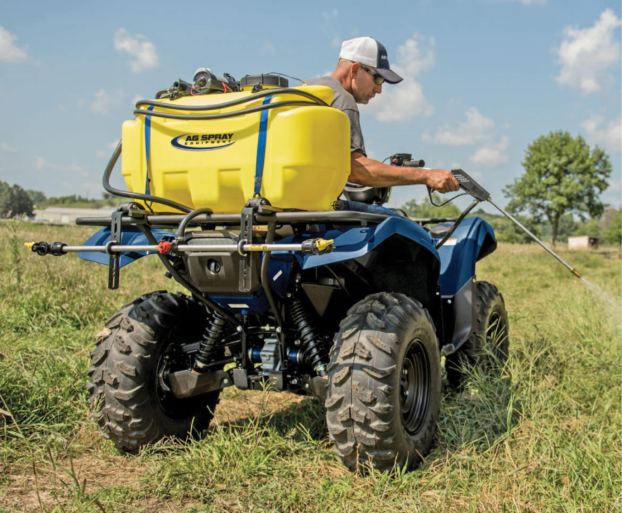
Other issues with calibration
Calibrated with hand-sprayer but not following through with proper technique.
Assuming a dual pesticide rig delivers consistent output from the boom or boom-less sprayer to the attached hand-sprayer.

Slide 29
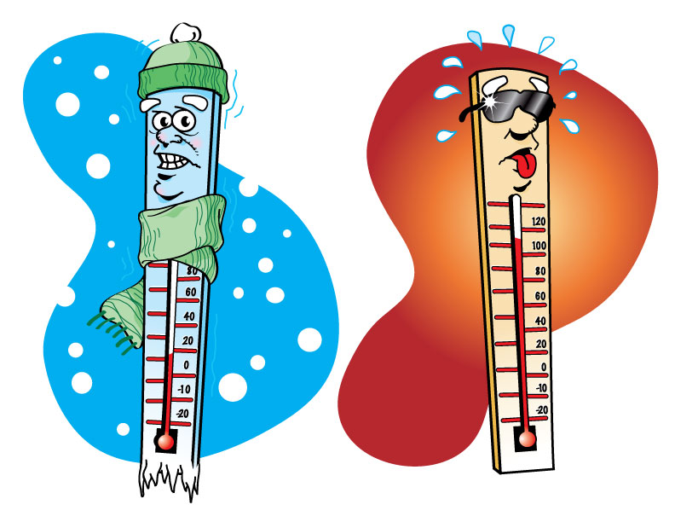
Environmental Conditions
Precipitation
Ideal Temperature
Ideal Wind Conditions
Timing of season.
Timing of life cycle of pest.

Slide 30
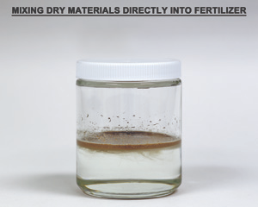
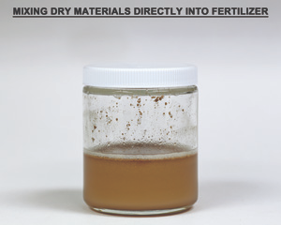
Tank Mixing Issues
Not agitating certain formulations
  i.e. Flowables, WP, WDG, EC and other oil based etc.
Agitating too much: creates foaming
Tank mixing incompatible formulations
  Adding oil-based products (i.e. EC) or adjuvants (i.e. ESO, COC) to the spray mix before adding the solid formulation products (i.e. WDG, WP). Since crop oil is less dense than water, the oil will stay on the liquid surface. Coats it and water can’t reach.
  Mixing UAN and adding various dry pesticide products without mixing in as a slurry.
Antagonism
  2-4,D and MCPA
  Amine and Esters
  Glyphosate and glyphosinate
  UAN and 2,4-D

Slide 31
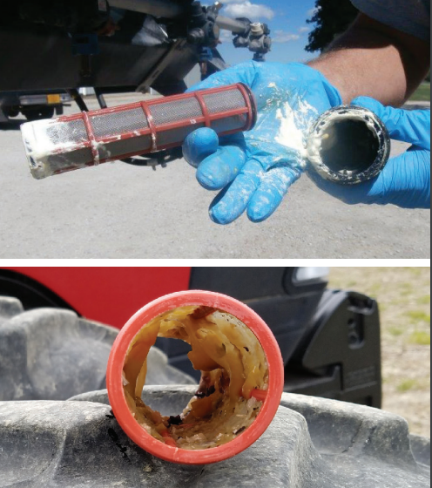
Other mixing issues
Temperature: “It took 22 minutes for sprayable ammonium sulfate to dissolve in 40°F water.”
Allow at least 5 min to dissolve for each product/adjuvant/fertilizer

Slide 32
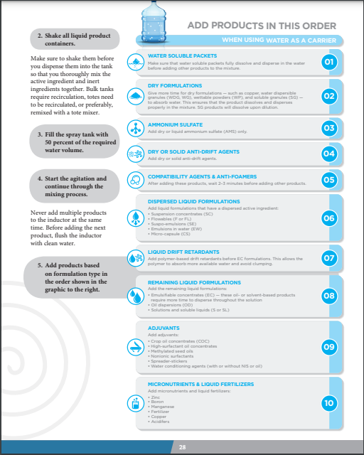
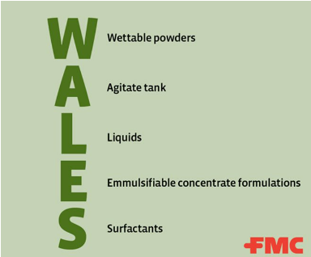
Tank Mixing Order
Always read label
Varies

Slide 33

OPEN DISCUSSION OF WHAT CAN GO WRONG
Cleaning tanks properly – Be wary of glyphosate, fertilizer mixes and ammonium-based pesticides as they will strip your tank of residuals.
Inexperienced applicators assisting. Be sure they are well trained.
Using pesticides that are inferior to other products.
Pesticide resistance

Slide 34
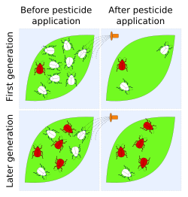
Resistance is the ability of a pest to tolerate a pesticide that it once was susceptible.

Slide 35
Resistance in Montana
ACCase (grass herbicides) and ALS-inhibitor herbicides (SU’s): Kochia, Wild oat, Russian Thistle. SU’s and grass herbicides
Glyphosate: Kochia, Russian Thistle and Marestail
Auxinic (dicamba and fluroxypyr): Kochia, isolated
ALS Herbicides (imazamox, procarbazone-sodium, pyroxsulam) - SU’s are in this class: Cheatgrass (downy brome)
Pyrethroids: Alfalfa weevil - Resistance to pyrethroids in many states, including Montana. Use indoxacarb “Steward”

Slide 36
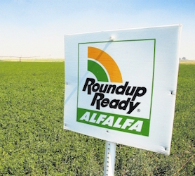
How to manage resistance
Use high rates of pesticides
Mix modes of action
Use non-chemical approaches when possible
Rotate crops
Beware of over-use in “Pesticide Ready” GMO crops “soybean, corn, sugar-beets, canola and alfalfa”; dicamba in soybean “NOT IN MT”

Slide 37
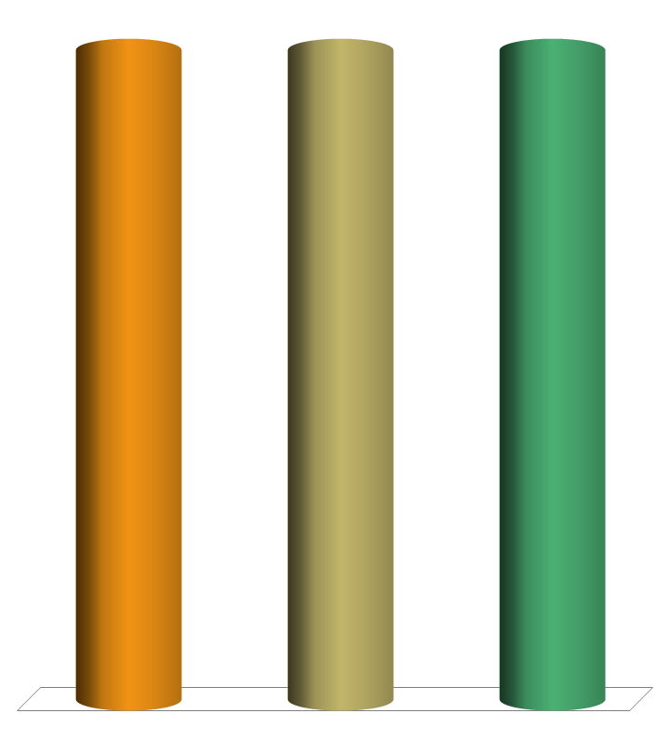
Will this presentation change your approach to pesticide applications (check water quality, add surfactants, tank mixing, calibrate, etc.)?
Yes
No
I already apply the information presented.

Slide 38

Be prepared
Good luck!
Contact
Cecil Tharp
(406)994-5067
CTHARP@MONTANA.EDU
WWW.PESTICIDES.MONTANA.EDU

