Slide 1
Impacts of Climate Change on Montana Ag
Drs. Zach Miller, Bruce Maxwell, Etc.
NWARC Winter Meeting, Jan 18th 2024

Slide 2
MSU-Western Ag. Research Center
Supporting High-Value, Horticultural Crop Producers in Montana

Slide 3
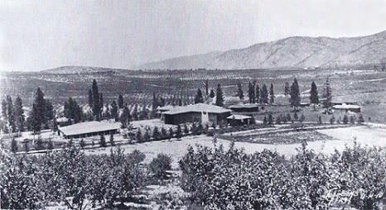
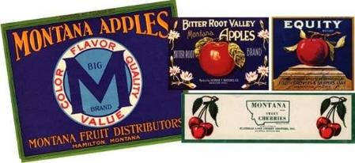
MSU-Western ARC
Corvallis, Montana
Established in 1907 during a Bitterroot Apple Boom
High-value crops
Berries, Apples, Cherries, Pears, Grapes, Veggies
What can be grown profitably and how to grow them.
Notes:
WARC: began with mission to serve fruit/veg growers during apple boom.
Climate is well suited for horticultural production

Slide 4
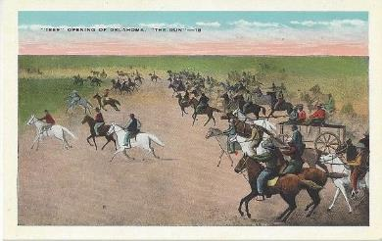
Mission-Specialty Crops
Higher farm returns to compete with development and preserve high quality ag. land
WARC mission is to use research and outreach to support these farmers and processors

Slide 5
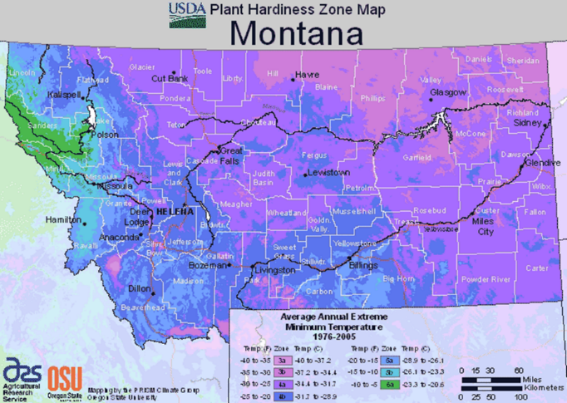
Western Intermountain Climates- cool and variable
Cool, dry climates provide a lot of pest control
Mountainous + Mid-Continent= Variable
Notes:
More hardy cider varieties include Binet Rouge, Harrison, Hewe’s Virginia Crab, and Wickson (Brown’s, Tom Putt, Stembridge)

Slide 6
Climate Adaption for Perennial Fruit Plants
Heat Units=Growing Degree Days
Frost Free Days
Risk of Cold Injury: Hard Frost
Risk of Cold Injury: Hard Frost/Sudden Cold
Risk of Cold Injury: Severe Cold

Slide 7
Variable Climate: Winter Minimum Temps
1 in 5 chance of -20° or colder
AVE=
-12.1° F

Slide 8
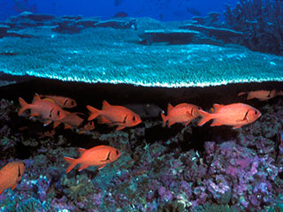
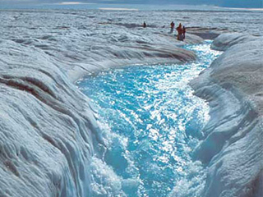

Slide 9
Montana’s Heating Up
Current average annual temperature is 45⁰F.
Increased by 0.42°F per decade since 1950. Overall increase of 2.7°F.
U.S. annual average has increased by 0.26ºF per decade since 1950.

Slide 10
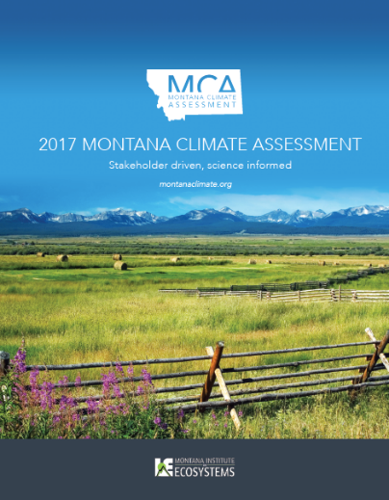
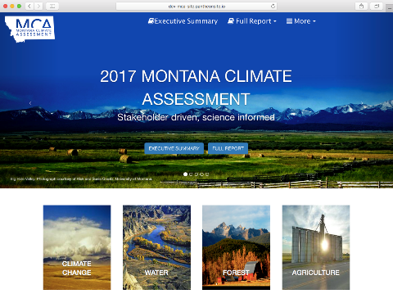
Montana Climate Assessment
http://montanaclimate.org
www.montanaclimate.org

Slide 11
Main point/Take home message
Climate impacts in MT:
Relatively small on the national, global scale
For Agriculture
Uncertain and complex
Longer, warmer growing season
More water demand and less irrigation and precipitation when need is greatest

Slide 12
Climate Projections
Global Circulation Model
Global model required
Complex
Course resolution
Projections can be sensitive to small differences in initial conditions- multiple runs
MT Climate Assessment =20 GCM
Model agreement

Slide 13
Prediction: Scenarios or Representative Concentration Pathways

Slide 14
Climate Prediction

Slide 15
Complexity=Uncertainty

Slide 16
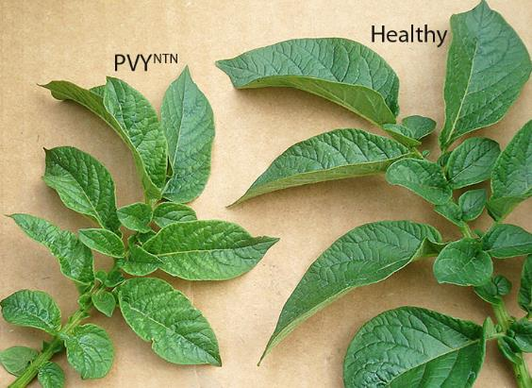
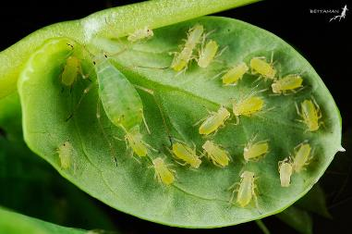
Turning up the heat: impacts
MT seed potato industry
11,000 acres
$42 million/yr.
Valued for virus-free seed potatoes
Dependent on cool, dry conditions
Climate changing to favor virus spread

Slide 17
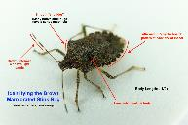
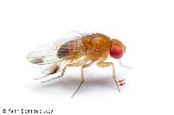
Warming may promote new pests
Brown Marmorated Stinkbug
Spotted Wing Drosophila
Apple damage ~$37 million

Slide 18
Temperature
Historical Trends
Plant growth (and pests)
Longer growing season (+14)
But is it predictable
Faster crop growth (GDD)
Rapid water use
New crops possible
Extreme heat (>90 F)
More frequent and projected to increase
Impacts on cool-season crops

Slide 19
Growing Degree Days (base 50⁰ F, April to October)
Increasing at most sites

Slide 20
Growing Degree Days (base 50⁰ F, April to October)

Slide 21
Growing Degree Days (base 50⁰ F, April to October)

Slide 22
Heat Units Increasing in Late Summer-Early Fall.
monthly and total GDDb50 | Missoula |  | Kalispell |  | St. Ignatius
 | slope | sig | slope | sig | slope | sig
April | -0.11 | NS | -0.04 | NS | 0.03 | NS
May | 0 | NS | -0.03 | NS | 0.21 | NS
June | 0.22 | NS | -0.01 | NS | 0.35 | NS
July | 0.77 | ** | -0.01 | NS | 0.7 | *
August | 0.98 | *** | 0.33 | NS | 0.83 | **
Sept | 0.68 | * | 0.18 | NS | 0.68 | *
Oct | 0.08 | NS | -0.06 | NS | 0.07 | NS
Total | 3.19 | *** | 0.41 | NS | 2.71 | ***

Slide 23
Can we count on a longer growing season?

Slide 24
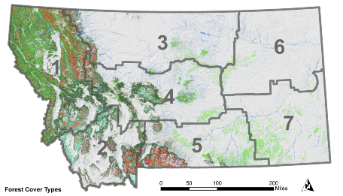
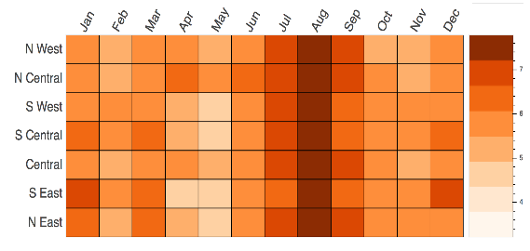
Monthly Temperature Projections
RCP 8.5 (2040-2060)
Winter: 5 to 7°F
Summer: 6 to 7.5°F
(100% model agreement)
Notes:
Average monthly temperatures are expected to increase across all climate divisions and both RCP scenarios (Figure 4.10). Summer and winter generally have larger projected increases than spring and fall. In the RCP 8.5 scenario, August has the largest projected change across all climate divisions.

Slide 25
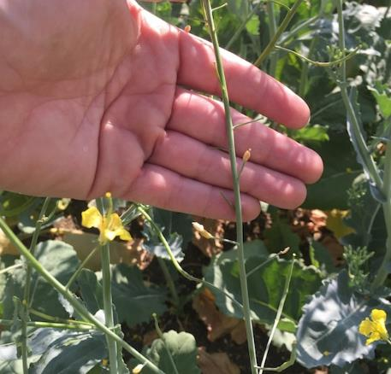
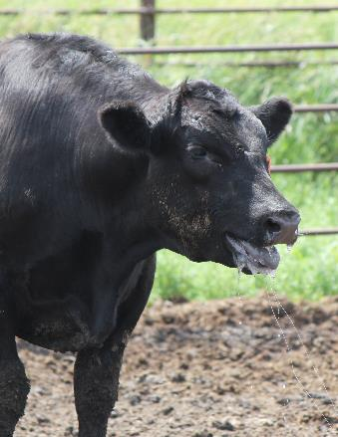
Extreme Heat

Slide 26
3x increase

Slide 27
Extreme Heat Projections

Slide 28
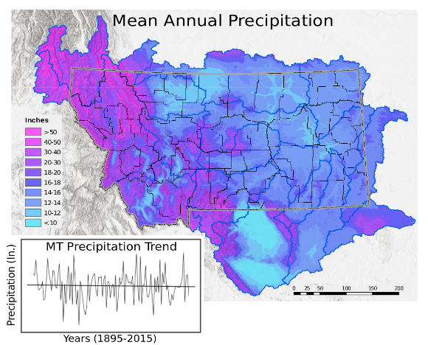
Montana Precipitation
Average annual precipitation is 18.7 inches.
Eastern MT: increased by 1.3 to 2.0 inches in spring
Northwestern MT: decreased by 0.6 inch/decade in winter or ~3.8 inches since 1950
Notes:
Moving on to a current look at precipitation, the amounts and form of precipitation falling as rain versus snow vary widely across the state. The majority of the wintertime precipitation in Montana falls as snow, and the water that accumulates in snowpack in the mountains is the most significant source of water to valley bottoms throughout the summer. This is also strongly influenced by elevation and proximity to the continental divide. Our current average annual precipitation across the state is 18.7 inches. Western Montana typically receives twice as much precipitation (~22-30 inches) annually as eastern Montana (~12-14 inches). The seasonal distribution of precip in western mt also much more even due to the flow of moisture rich air from the Pacific Coast. For eastern and central Montana, between 65% to 75% of the annual precipitation occurs in the late spring and summer months.
Statewide, the amount of average annual precipitation has shown no statistically significant trend over the past 65 years.

Slide 29
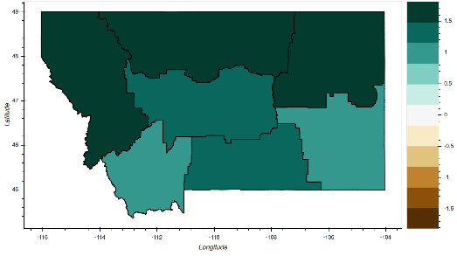
Annual Precipitation
RCP 8.5 (2040-2060)
1.5 in
1.0
0.5
0
-0.5
-1.0
-1.5
Variability across regions
From 1.1 to 1.6 more inches
Model agreement: 85%
Notes:
Average annual precipitation is expected to increase by mid-century across the state in both RCP scenarios with moderately high agreement among models. In RCP 4.5, increases around 1.3 in/yr are expected in the northwestern parts of the state. In the southern and eastern parts of the state, increases around 0.9in/yr. In the RCP 8.5 scenario, average annual precipitation is projected to increase by around 1.6 in/yr in the northwestern portions of the state and around 1.2 in/yr in the southern and eastern portions of the state.

Slide 30
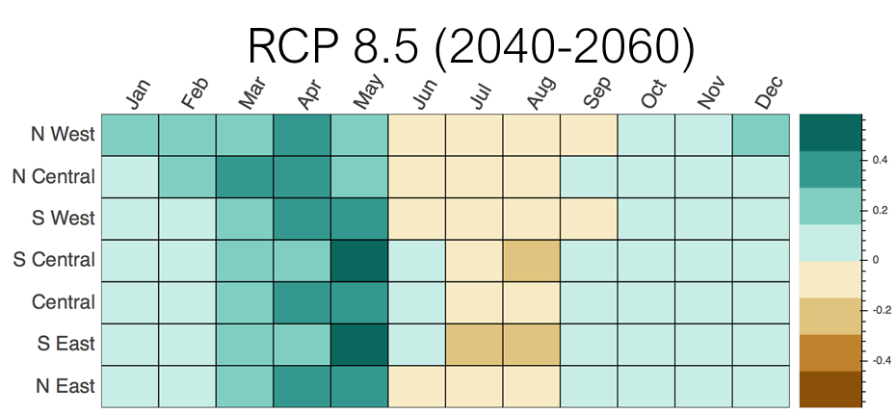
Monthly Precipitation
in. different from 30 yr mean
Model agreement: 85%
Notes:
While annual increases in precipitation are expected across the board with moderately high model agreement, the monthly and seasonal projections are more diverse. Winter, spring, and fall are all projected to have increases in precipitation in both RCP scenarios with spring expected to have the largest increases (Figure 4.25).In the RCP 4.5 scenario, spring months are expected to increase around 0.2 in/mth (minimum: -0.1 in/mth, maximum: 0.8 in/mth, percent agreement: 85%). In the RCP 8.5 scenario, spring months are expected to increase around 0.4 in/mth (minimum: 0.0 in/mth, maximum: 1.0 in/mth, percent agreement: 95%). The summer months, however, are expected to have decreasing precipitation in both scenarios, although model agreement is fairly low for these projections (Figure 4.25). In the RCP 4.5 and 8.5 scenario, summer precipitation is expected to decrease by around -0.1 in/mth (minimum: -0.4 in/mth, maximum: 0.5 in/mth, percent agreement: 65%).

Slide 31
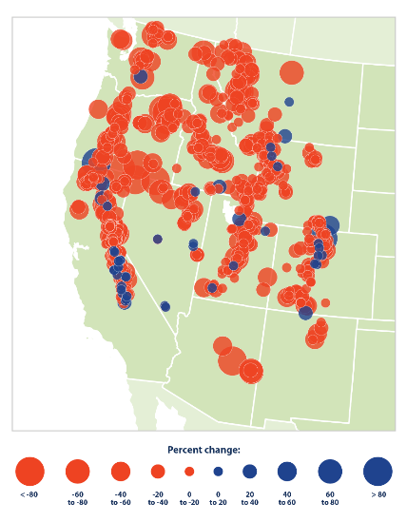
Snowpack trends
Red = declining snowpack
Blue = increasing snowpack
Warmer winters = less snowpack
1955-2016
Mote and Sharp 2016

Slide 32
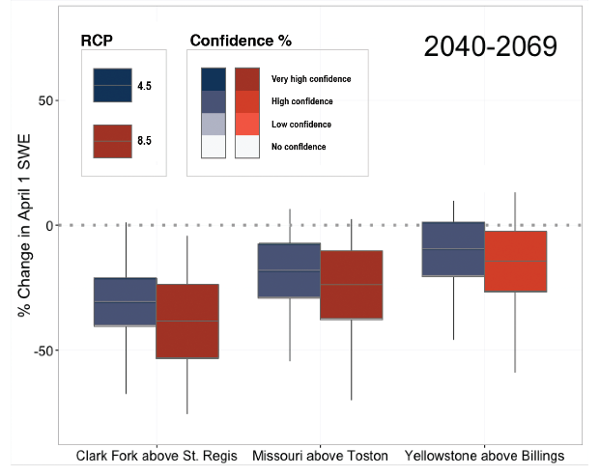
Projections of Future Snowpack Snow Water Equivalent (SWE)
Reductions of up to 50%; high to very high model agreement

Slide 33
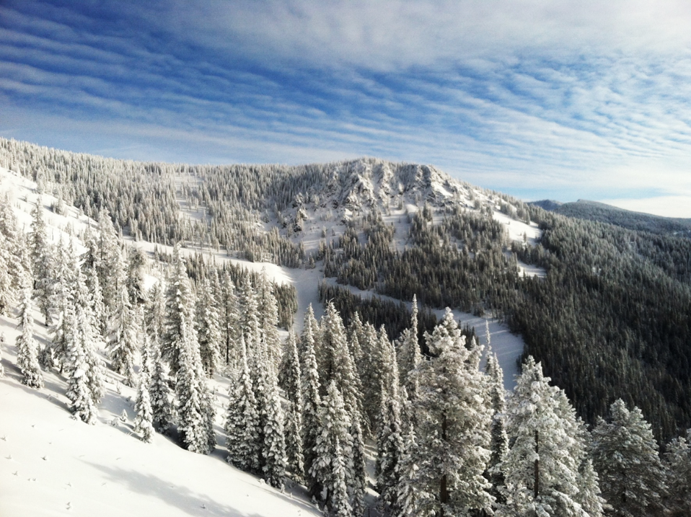
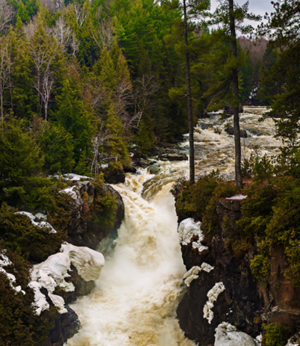
KEY MESSAGE: SNOWMELT & RUNOFF TIMING
Observed trends shows shift toward earlier snowmelt and shifts in timing of runoff
Increasing temperatures are very likely to cause this pattern to continue
Changes in runoff timing may result in reduced late-summer water availability for northwest MT

Slide 34
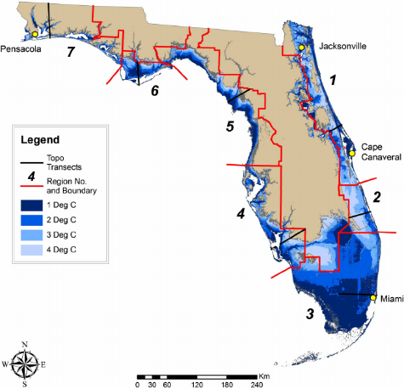
Main point/Take home message
Climate impacts in MT:
Relatively small on the national, global scale
For Agriculture
Uncertain and complex
Longer, warmer growing season, but can we count on it?
More water demand and less irrigation and precipitation when need is greatest
How pests (weeds, disease, insects) will respond is not well understood.

